Slide 1
Asia LEDS Partnership: Highlights
John Bruce Wells, Asia LEDS Partnership Secretariat

Slide 2
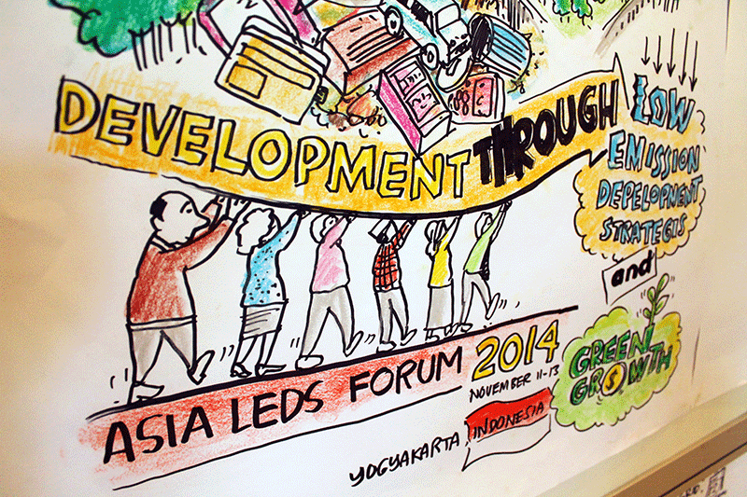
Snapshot
Membership: 128 organization members and an additional 203 individual members (September 30, 2015)
Member prioritized themes for collaboration (2015 – 2016)
Sectors: AFOLU, Energy
Cross-cutting: Benefits Assessment, Finance

Slide 3
Focus Area 1: Assessing and communicating benefits of LEDS
Priority: Capacity building on using economic benefits assessment tool(s), and applying results for decision making
Activities:
Publish case studies on LEDS-related modeling and decision support tools (e.g., use of Asia-Pacific Integrated Model policy support in Thailand)

Slide 4
Focus Area 2: Policy formulation and decision making for LEDS in priority sectors
Sector(s): AFOLU, Energy
Priority: Capacity building on low-emission land use planning and low-emission energy planning
Activities:
New “Training Resources” section on ALP website to direct members to existing, high-quality training
In-person training in support of low emission approaches in agriculture
Webinar series on tools to help advance low emission energy planning

Slide 5
Featured Activity: Training Curation
Challenge: “Good resources are out there, but there is information overload and resources are too dispersed.”
Response: Review available training resources in priority LEDS topics. Curate information to streamline access for members through the ALP website.
Result: Launched new “Training” section on ALP website. First curriculum on “Overview of LEDS and the LEDS Process” is comprised of free, online, quality resources from more than 20 content developers worldwide on how to advance steps of the LEDS process.
Next steps: Two more curricula on the way!

Slide 6
Focus Area 3: Financing LEDS and green growth implementation
Sector(s): AFOLU, Energy
Priority: Learning and sharing on investment planning, financing instruments, enabling environments to mobilize private investment
Activities:
Regional workshop on “Mobilizing Investment for LEDS in Asia’s Agriculture Sector – Crop Production and Value Chains” in Vietnam, October 2015
Guest blog series on ALP website to share insights on innovative finance approaches in energy sector
Support global Clean Energy Grid Integration Network activities in Asia, including on mobilizing investment

Slide 7
Special Topic: Intended Nationally Determined Contributions (INDC)
Priority: Integrate the international discourse on INDCs and use the ALP as a forum for knowledge sharing on this national and global initiative
Activities:
Publish issue briefs on country progress and support resources available to countries
Include panel or group work session on INDC updates and learning at ALP events

