Slide 1




National Planning Department

Slide 2
  Mobilizing private investment for
  low carbon development
October 14th, 2015

Slide 3
1. Low carbon development in PPP projects

Slide 4
Colombian Regulatory
Framework for PPPs
General provisions
The law applies to all sectors– minimum project investment: USD 1.7 million.
Maximum term including extensions– 30 years*
Limit to additions and extensions of contracts with public budget– 20%
In PPPs the payments are subject to the levels of service and availability of the infrastructure.
II. PPP of public initiative
III. Unsolicited PPP proposal
Public Idea:
Private idea: Only for new projects
Resources:
Private and/or Public
Selection Process:
Public Bidding
Resources:
Private + max. 20% Public
Selection Process:
Public Bidding
Resources:
100% Private
Selection Process: Abbreviated selection
IV. PPP project’s common provisions
Project funds are managed through SPV.
Creation of a new database of PPP projects.
Proper budget management to guarantee future payments.
The infrastructure reverts to the public sector
* This term can be extended only if there is a previous favorable concept from the National
Council for Economic and Social Policy (CONPES).

Slide 5
  PPP Basic scheme
State Entity
Disbursement of
public funds
Long-term contract based
on service delivery
Private Investor
Users
Banking
Services
Creditors
Resource Management
Capital Markets
Debt
SPV
Shareholders
Stock
Operational revenue
Operating Agreement
PaymentsO&M
Construction payments
Construction
contract
Operator
Coordination
Constructor

Slide 6
  Colombian PPP initiatives related to low carbon development
Sustainable transportation
Light rail transit systems
Public bike system
Waste management
Waste to energy
Solid waste treatment plant
Water public transport
Public light modernization
Sustainable Energy
Clean technologies for public bus fleet

Slide 7
Incorporation of environmental indicators for PPP
1
The construction and operation of PPPs can have a direct impact on the environment due to the use of natural resources and waste disposal during the construction and operation of the public infrastructure.
2
On September 2013 the National Planning Department, supported by USAID, NREL, the UK Embassy and UNEP; conducted the international workshop " Exploring the low carbon development through public-private partnerships".
3
The National Planning Department is currently working to develop set of environmental indicators that could be introduced in PPP projects for the sectors of airport, roads, health, education and public buildings.

Slide 8
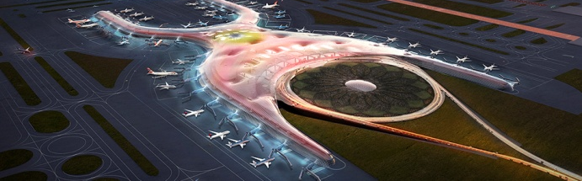
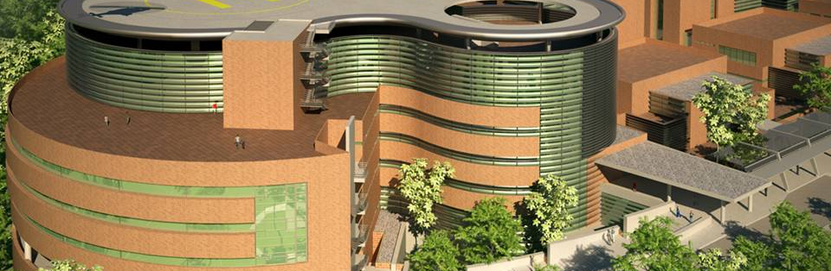
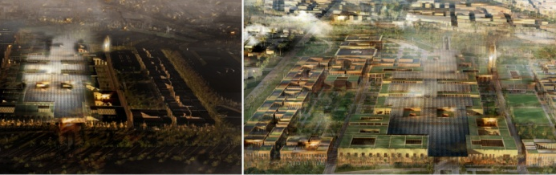
3.1
International and national benchmarking

Slide 9
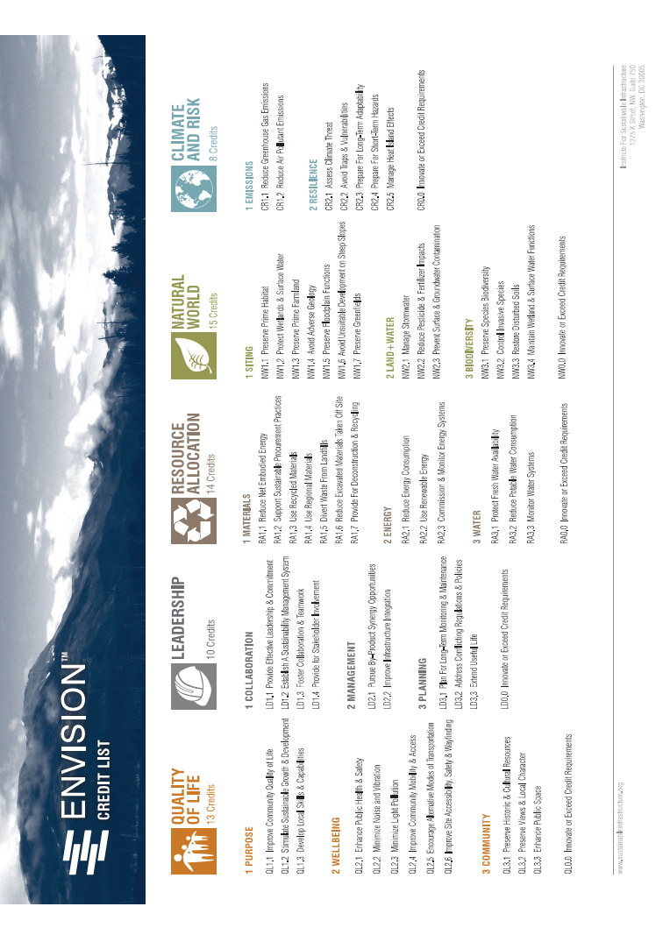
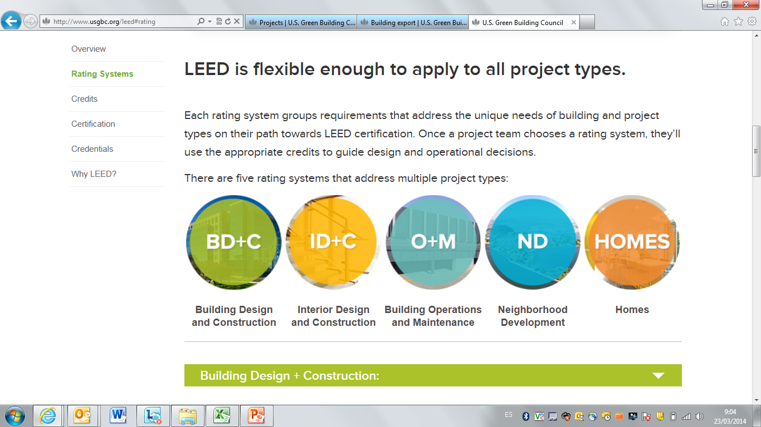
3.2
Comparative analysis
LEED
COLOMBIAN GREEN LABEL FOR SUSTAINABLE BUILDING (DRAFT)
SUSTAINABLE BUILDING CODE
OTHERS: COLOMBIAN LOW CARBON DEVELOPMENT STRATEGY, NATIONAL ADAPTATION PLAN ON CLIMATE CHANGE, GREEN PROTOCOL

Slide 10
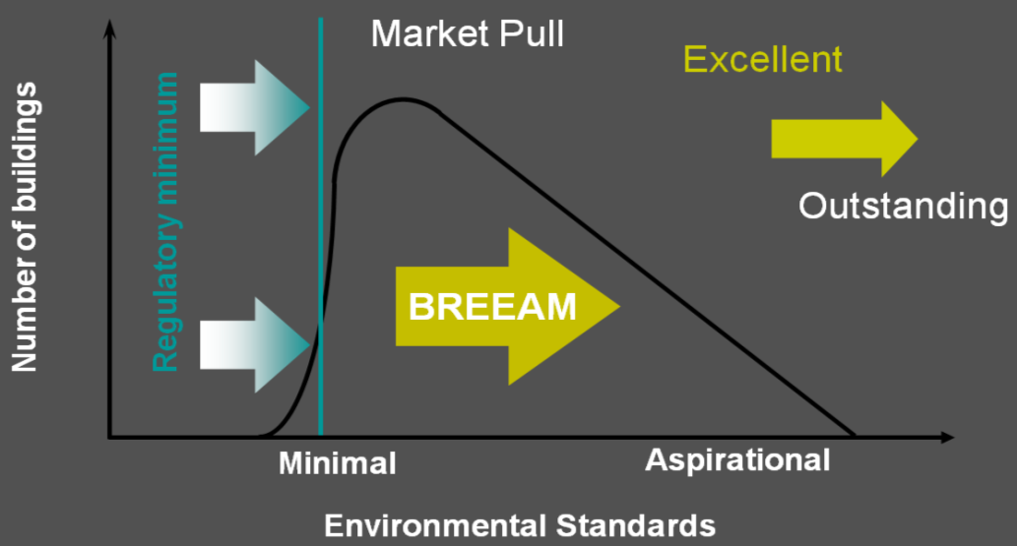
3.3
Environmental indicators and implementation guide
Enviromental indicators

Slide 11
2. Innovative financial mechanisms

Slide 12


  Background on interagency coordination
The Green Protocol was signed on 2012 by the Colombian Government and banking institutions to promote sustainable development, environmental preservation and sustainable use of natural resources.
The Financial Committee on Climate Change was created on 2013 to facilitate interagency coordination on climate change. Its main objective is to define policies to promote scalable and sustainable climate finance.

Slide 13
  Barriers for climate finance
Study of barriers for climate finance in Colombia
(2013-2014)
Technical study on barriers for the private sector
(2014-2015)
Underdevelopment of financial instruments to address climate change.
Lack of strategies to encourage private sector involvement on climate finance.
Lack of demand for green credit lines.
Lack of training for banking commercial agents.
Greater coordination among all actors to promote climate finance is required.

Slide 14
  Objective and workplan
OBJECTIVE
Generate innovative financial mechanisms in the larger GHG emitter sectors of the country, aligned with the Colombian challenges on green growth and as a result of a joint effort between the private and public sectors.
PHASE 5
PHASE 4
Socialization
PHASE 3
Implementation of the Pilot
Designing pilots of financial innovation
PHASE 2
Business opportunities
Measures to
be taken
2018
PHASE 1
Sector overview
Industry trends
Review trend incentives
2017
2016
2015

Slide 15
  Sectors and actors
Coordination
Support
Sectors
Climate Change Financial Committee
Green Protocol
Green Climate Found Readiness Program
LCRD / USAID
Transport
Housing
Mining
Agriculture
Industry
Energy
Financial sector
One lead bank for each sector
One or two supporting banks for each sector
Public sector
Frankfurt School
Ministry of Environment
National Planning Department
Ministries for each sector
Private sector
Guilds and industry associations

Slide 16

  National Planning Department
www.dnp.gov.co
Notes:
Colores menos chillones Cian y Magenta

