Slide 1
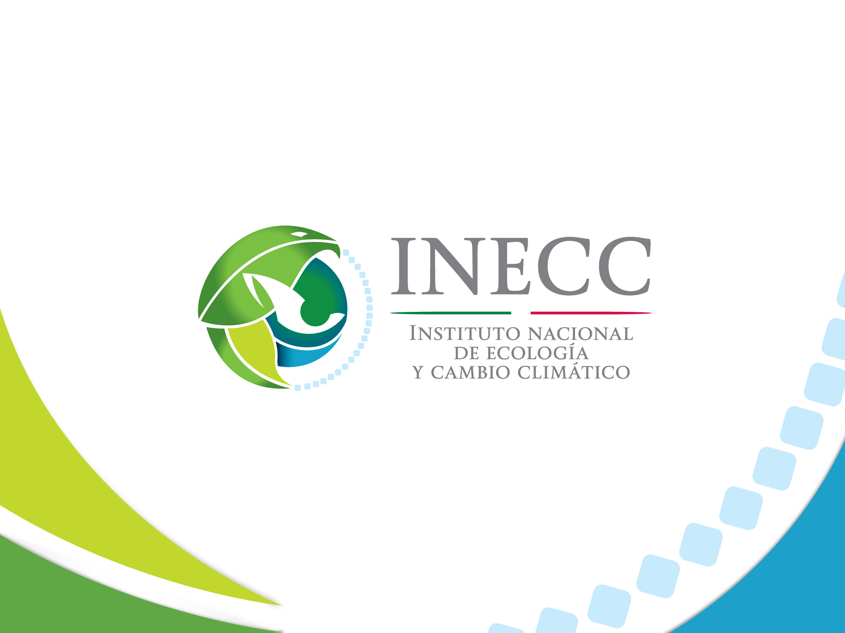
Examples of benefits assessment of low emissions development
Iris Jiménez
National Institute of
Ecology and Climate Change
Mexico
October 14th.2015

Slide 2

Some approaches that Mexico has taken for assessing and communicating LEDS benefits
Research
  Modelling with ThreeME
Communication at Project level
  Low Emissions Capacity Building Program (LECBP-México).
Assessment at Policy Level
  Assessment of Climate Change Policy
Notes:
Approaches Mexico has taken for assessing and communicating LEDS benefits and lessons learned.

Slide 3
Transiting to a low carbon economy in Mexico: an application of the ThreeME 2014-2050
ThreeME framework, a Multi sectoral Macroeconomic Model based on the Keynesian theory. It is designed to address dynamics of global economic activity, energy system and carbon emissions.
Originally funded by the French Environment and Energy Management Agency (ADEME) to estimate the macroeconomic of prospective scenarios for energy transition.
Research collaboration involving the National Institute of Ecology and Climate Change (INECC), the French Economic Observatory (OFCE) and the French Agency for Development.
It is a general equilibrium model (CGEM) to analyze the effects of the transfer of activities from one sector to another and feedback between supply and demand.
It was adjusted to Mexican reality to simulate medium and long term impacts of proposed and future energy and fiscal policy. It combines a macroeconomic modeling (top-down) and a technical modelling of energy consumption (bottom-up).

Slide 4
Transiting to a low carbon economy in Mexico: an application of the ThreeME 2014-2050
ThreeME framework, a Multi sectoral Macroeconomic Model based on the Keynesian theory. It is designed to address dynamics of global economic activity, energy system and carbon emissions.
Originally funded by the French Environment and Energy Management Agency (ADEME) to estimate the macroeconomic of prospective scenarios for energy transition.
Research collaboration involving the National Institute of Ecology and Climate Change (INECC), the French Economic Observatory (OFCE) and the French Agency for Development.
It is a computable general equilibrium model (CGEM) to analyze the effects of the transfer of activities from one sector to another and feedback between supply and demand.
It was adjusted to Mexican reality to simulate medium and long term impacts of proposed and future energy and fiscal policy. It combines a macroeconomic modeling (top-down) and a technical modelling of energy consumption (bottom-up).

Slide 5
ThreeMe for México. 2014-2050
Scenario | Policy | Redistribution of carbon taxes
S1A | Removing energy subsidies | No
S1B | Removing energy subsidies + implementing carbon taxes | No
S2 | Removing energy subsidies + implementing carbon taxes | Yes
S3 | Removing energy subsidies + implementing carbon taxes + changes in energy matrix | Yes
Notes:
Full redistribution of carbón taxes revenues among consumers

Slide 6
Some results from Macroeconomic simulation
(Redistribution versus Non-redistribution)
At the scenario with redistribution (S2), the distribution of carbon tax revenues and subsidies can reconcile environmental and economic objectives: the effect on GDP and consumption is positive.

Slide 7

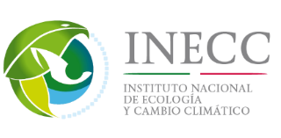

LECBP-MEXICO
    BETTER UNDERSTANDING OF SECTORIAL EMISSIONS
  Handbook and workshops on MRV tools (GHG Protocol, IPCC methodologies).
  Capacities building for private sector to help the implementation of on-line tool for National Emissions Registry.
IDENTIFYING MITIGATION OPPORTUNITIES
  Quantifying the economic saving of adoption of industrial cogeneration.
DEVELOP LOW CARBON DEVELOPMENT STRATEGY
  Sign of agreements with the industry to develop the document which contain the elements for LEDS.
Notes:
Capacitación en uso COA- Web- desarrollo de materiales y 40 cursos (de un día para industrias y medio día para servicios) para alrededor de 40 asistentes a c/u. (1600 personas).
OPORTUNIDADES: Los 10 sistemas resultaron rentables con periodos de retorno a la inversión de 2 a 5 años.
ESTRATEGIA: *The Sectoral Decarbonisation Approach (SDA) is a freely available open-source methodology that allows companies to set emission reduction targets in line with a 2°C decarbonisation scenario. It is based on the 2°C scenario (2DS) developed by the International Energy Agency (IEA) as part of its publication, Energy Technology Perspectives 2014 (IEA, 2014). The methodology was developed by CDP, WRI and WWF with the technical support of Ecofys
Contenidos:
escenarios de desarrollo, línea base del sector, oportunidades de reducción de emisiones ( estudio del programa y revisión bibliográfica)
metas para contribuir a INDC y metas para lograr 2°C (SDA)*
concusiones y recomendaciones.

Slide 8
Lessons learned to communicate LEDS benefits
Achieving interest in the development of the Strategy
  Communicate first the actions with economic benefits.
  Relying on legal obligations (GHG National Emissions Registry) and analysis of opportunities and threats.
  Diversify options to internalize environmental costs (carbon market, emissions taxes, tariffs or import barriers).
Increasing green investment through:
  incentives to reduce emissions and encourage profitable projects that reduce emissions (preferential financing and regulatory facilities, clean or certified emission reduction).

Slide 9
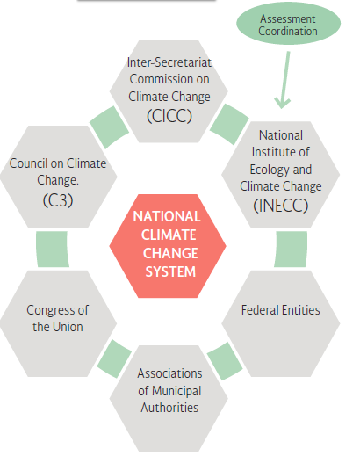
Assessment of Climate Change Policy
Challenges:
Defining what will be evaluated among all the aspects of climate change policy.
MRV and assessment methodologies.
Communicate progress and delays related to national commitments.
Incorporate feedback and recommendations into climate change policy.
Climate Change Policy Assessment Office
National Institute of Ecology and Climate Change
6 Social Advisers
(academic, scientific, and private sector)

Slide 10
Thank you
Iris Jiménez
iris.jimenez@inecc.gob.mx
National Institute for
Ecology and Climate Change
Mexico

