Slide 1

LEDS GLOBAL PARTNERSHIP
Advancing Climate-Resilient Low Emission Development Around the World
October 14-16, 2015
LEDS GP Annual Workshop
Punta Cana, Dominican Republic
Ron Benioff, LEDS GP Co-Director
www.ledsgp.org

Slide 2
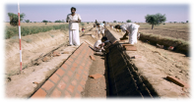


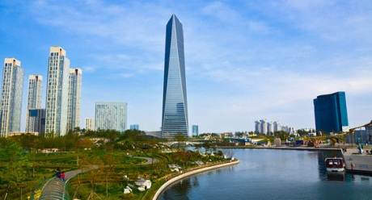
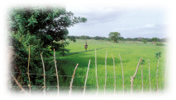
Why Pursue Low Emission Development?
Reduce poverty and create new economic opportunities
Enhance industrial / resource efficiency and productivity
Increase energy security and economic development
Improve health and economic activity from less pollution
Urgent need to scale up GHG emission reductions and improve climate resiliency
Content adapted from World Bank
Notes:
Adapted from World Bank training slide

Slide 3
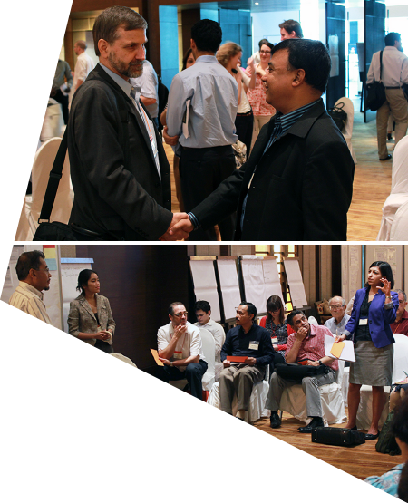
LEDS GLOBAL PARTNERSHIP
Advancing Climate-Resilient Low Emission Development Around the World
Mission
Harness the collective knowledge and resources of governments, donors and international organizations, and practitioners in scaling up and strengthening implementation of climate-resilient low emission development around the world.
Objectives
Strengthen quality, coordinated support, and leadership of low emission climate resilient development strategies by countries in all regions
Foster effective implementation of LEDS
Spur development of new LEDS by additional national and sub-national governments

Slide 4
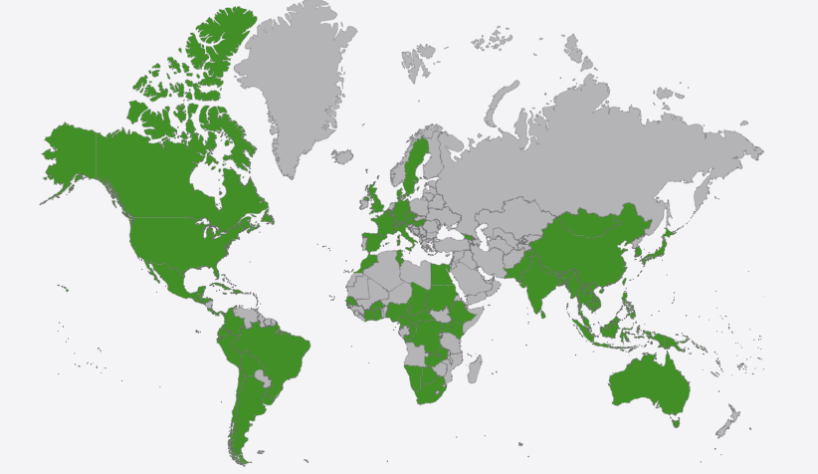

LEDS GP MEMBERS
LEDS GP Catalyzes Action and Collaboration Across more than 160 Countries and International Organizations
Notes:
Map made from http://www.amcharts.com shows the 78 countries that participated in LEDS GP events from Oct 2013 – May 2014

Slide 5






LEDS GP ORGANIZATIONAL STRUCTURE
IMPROVED LEDS
REGIONAL PLATFORMS
STEERING COMMITTEE
define priorities, lead peer learning, and support delivery
SECRETARIAT
coordinates implementation
sets strategic direction
GLOBAL WORK STREAMS
Provide technical support and training

Slide 6

REGIONAL PLATFORMS ARE HEART OF LEDS GP
Africa LEDS Partnership Co-led by Kenyan Ministry of Environment, Cote D’Ivoire Ministry of Environment and the KNUST University in Ghana | Priorities AFOLU and REDD+ Energy Infrastructure and urbanisation Linking LEDS and climate resilience Institutional arrangements
Asia LEDS Partnership (ALP) Co-led by Indonesia National Council on Climate Change (DNPI) and USAID Low Emissions Asian Development (LEAD) Program | Priorities LEDS planning in AFOLU and Energy Mobilizing finance for LEDS implementation Assessing benefits of LEDS
Latin America and Caribbean Platform (LAC) Co-led by INCAE Business School (Costa Rica) and Libélula (Lima, Peru) Sponsored by Inter-American Development Bank | Priorities Economic and financial instruments National-subnational articulation and subnational LEDS MRV and information Private sector involvement Linking LEDS and resilience
122 MEMBER ORGANIZATIONS
128 MEMBER ORGANIZATIONS; 203 INDIVIDUAL MEMBERS
511 INDIVIDUAL MEMBERS
102 MEMBERS REPRESENTING THEIR ORGANIZATION

Slide 7

GLOBAL WORK STREAM ACTIVITIES
LEDS Planning Sub-national Integration of LEDS LEDS planning processes Integration of climate resilience & LEDS | LEDS Analysis Models and Tools Benefits and development impact assessment Analysis toolkits and training
Finance – Work Group Covers All Three Topics Private sector investment instruments Accessing donor funds Government funding | Sectors Agriculture, Forestry and Land Use Energy Transport Waste in partnership with CCAC
Work Groups in Bold

Slide 8

WHAT UNIQUE SERVICES DOES THE LEDS GP OFFER?
Peer learning and knowledge sharing
Regional and global workshops and forums for
peer exchange and training on LEDS topics
Web seminars
New fellowship program in 2016
Technical collaboration - connecting experts and resources
No cost expert assistance on analysis, finance, sector measures,
and planning
Case studies and conceptual frameworks across the working groups
Tools and toolkits (transport, development benefits, etc.)
Global resources – cultivating and supporting champions
Activity and LEDS leadership/good practice inventory
Thought leadership papers
Communication resources – fact sheets, success stories, presentations
New award program

Slide 9
LEDS GP PERFORMANCE GOALS AND PRIORTIES
2015 Priorities
Building enduring momentum for country driven LEDS in all regions
Mobilizing investment in LEDS
Facilitating access to assistance with LEDS design & implementation
Performance Targets
By 2016 | By 2020
65+ government agencies improve programs | 100 + government agencies improve programs
20 + international agencies/programs strengthen support | 20 + international agencies/programs strengthen support and collaborative programs enabled across at least 10 donors
2000 + practitioners strengthen capacity | 5000 +practitioners strengthen capacity
125 + new government officials join | 500 + new government officials, NGOs, and private sector institutions join
 | Enabled LEDS finance/investment partnerships for 20 + governments

Slide 10
STRATEGIC ENHANCEMENTS UNDERWAY
Deepen and tailor peer learning and technical collaboration on 2-3 selected priority topics per region
  Increased attention to implementation support
Strengthen communities of practice, knowledge exchange, and support for innovation
Improve access to resources and assistance from current programs
Diversify funding base and deepen partnerships
Engage more diverse stakeholders
What are your recommendations?

Slide 11
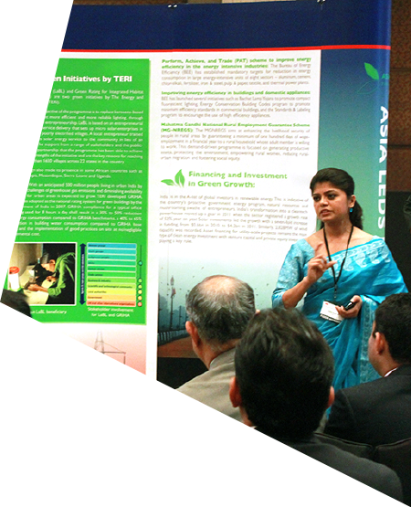
COUNTRY MEETINGS ON ADVISORY SUPPORT
Meetings scheduled with many country teams
Identify needs and opportunities for LEDS
expert/peer assistance
Plan for delivery of support
Seek feedback on how we can improve this service and LEDS GP overall
Please let us know if you have not been contacted and would like to meet
Can also talk at LEDS GP booth at the marketplace
Contact Bethany Speer, Caroline Uriarte, or Jebi Rahman to schedule a consultation
Can submit request for support anytime at http://ledsgp.org/assistance

Slide 12

YOU DRIVE THE PARTNERSHIP
At the Workshop – Lean In
Pursue priority needs and opportunities for learning, assistance, and collaboration
Share your experiences and recommendations to
improve the LEDS GP
Identify how you will apply learning and new partnerships
Use opportunity to explore new, innovative ideas
Stay Engaged After the Workshop
Engage with regional platforms and work groups
Contribute communication materials, to activity inventory, and new award program
Lead new activities
Please join the LEDS GP and encourage others to join.
www.ledsgp.org

Slide 13

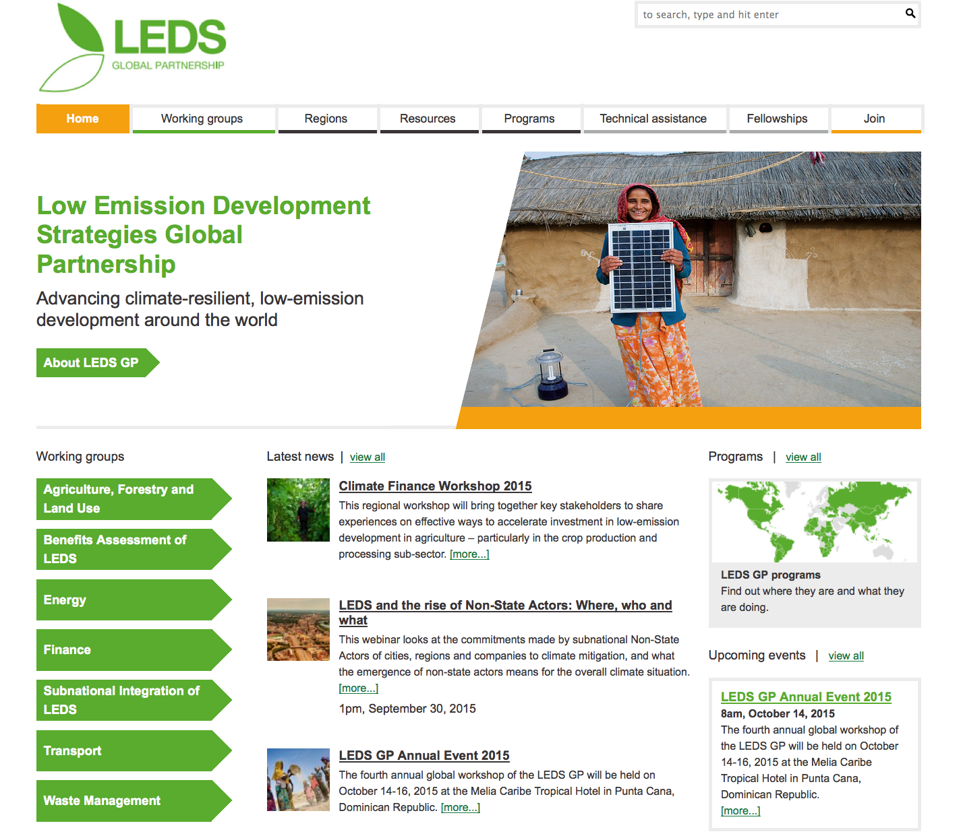
CONTACTS AND RESOURCES
Website:
www.LEDSGP.org
Secretariat
(NREL and CDKN):
Jebi Rahman
jebi.rahman@cdkn.org
Caroline Uriarte
caroline.uriarte@nrel.gov
Ron Benioff
ron.benioff@nrel.gov

