Slide 1
LEDS Global Partnership Finance Working Group
Annual Event, Punta Cana, Dominican Republic
October 14th, 2015
Donald Pols
Ms. Nguyen Thi Dieu Trinh
Co-chairs, LEDS GP Finance Working Group (FWG)

Slide 2
Introduction to the LEDS-GP Finance Working Group
Ms. Nguyen Thi Dieu Trinh
Ministry of Planning and Investment, Government of Vietnam

Slide 3
The LEDS-GP Finance Working Group
Mission statement of FWG
support the development of national and subnational finance and funding strategies through coordination, information exchange and peer-learning.
Co-chairs of FWG
Members (selected list)
Bajo en Carbono, Bangladesh Department of Energy, Brazil Ministerio do Meio Ambiente, Cambodia Climate Change Dept., CCAP, CDKN, CSTEP, CTI-PFAN, Danish Energy Agency, E3G, ECN, Ecofys, EMBARQ India, GIZ, IFC, Indonesia State Ministry of Development Planning, International Resources Group, Lycos, Ministry of Foreign Affairs of Denmark, NREL, Thailand National Economic and Social Development Board, UNDP, UNEP, UNEP-Risoe, USAID, Vietnam MPI, WEF, Worldwatch Institute, and WRI, World Bank

Slide 4
FWG planned regional activities 2015/2016
Asia LEDS Partnership
Regional workshop – Mobilizing Private Investment for Green Growth and Low-Emission Development in the Agriculture Sector in Asia – hosted by MPI, Vietnam in Ho Chi Minh City, October 2015.
Focus is on agriculture, rural areas and livelihoods; main target audiences of government (state banks and ministries), commercial banks (local and international), NGOs active on-the-ground, and the private sector.
Latin America & Caribbean Regional Platform
In-depth training on accessing climate finance.
Organise a joint webinar targeted to the LAC region.
Africa LEDS Partnership
Develop, document and disseminate to all AfLP members examples of two good cases of how governments are developing national LEDS or green growth finance facilities.
Investor matchmaking portal for African countries.

Slide 5
Global work of FWG 2015/2016
Developing thought leadership pieces, including a high-level conceptual framework on finance for LEDS.
Sponsoring peer-learning activities including case studies and webinars - on domestic government fiscal instruments, attracting private investment for green growth, accessing international public finance such as through the NAMA Facility and Green Climate Fund (GCF).
Ad-hoc expert assistance (depending on needs of practitioners)
In-country support (pending successful fundraising)
Support on the design and development of specific investment mobilization instruments
Concrete support to countries on their GCF proposals
Support developing financing strategies for country INDCs, when there is a clear request originating from the countries themselves

Slide 6
Priority topic areas of the FWG
The FWG will centre activities around the following 3 thematic areas:
National fiscal policy instruments and impact on LEDS financing
How to create an enabling environment for LEDS financing.
Attracting private sector investment into LEDS
Mobilising private investment through effective policies and financial instruments.
Accessing international finance for LEDS implementation
Understand sources of funding and their requirements.
Sources include the NAMA Facility, GCF, IRENA.

Slide 7
Aspirations for the next 12 months (before LEDS Annual Event 2016)
Sub-working groups established for each priority topic (across regions / themes)
Collaborative thought leadership pieces / products developed from the working groups.
At least one webinar on each priority topic delivered.
Ad-hoc expert advisory service delivered across three topics.
Additional funds mobilized, leading to:
Specific innovative financial instruments designed.
GCF proposals submitted.
Financing strategies for INDCs articulated.

Slide 8
Finance Working Group Training Sessions
Donald Pols
ECN

Slide 9
Finance training sessions
Dual objectives
CAPACITY DEVELOPMENT: Deliver interactive training sessions including hands on exercises with tangible examples and practical experiences.
FWG STRATEGIC DIRECTION: Training sessions are an opportunity to engage directly with LEDS-GP members to define concrete activities moving forward.
Desired outcomes for participants
Improved knowledge and practical skills for countries in applying ‘innovative’ financing solutions for LEDS development and implementation.
Desired outcomes for the FWG
Validation of the priority topics of the FWG.
Which LEDS finance topics are of particular interest and relevance to your country? → An inventory of related LEDS financing topics and activities the FWG could explore further.
In what ways can the LEDS GP FWG provide support to your country? → An inventory of specific financing mechanisms / instruments / strategies for which the FWG could provide in-country support.

Slide 10
Finance training sessions - LEDS GP Annual Event
4 finance training sessions
Session 1
(USAID; IADB)
‘Financial and innovative risk mitigation instruments’
Session 2
(WB Group; CIF; Vietnam’s MPI)
‘Investment planning for low emission development’
Session 3
(ECN, GCF)
‘How to mobilize private sector investment into low emission infrastructure’
Session 4
(WB Group; IFC)
‘Innovative solutions to climate finance: Blended finance for private sector projects’
Notes:
IADB – Inter America Development Bank
WB – World Bank
CIF – Climate Investment Funds
MPI – Ministry of Planning and Investment

Slide 11
Finance training session 1
Title: ‘Financial and innovative risk mitigation instruments’
Day 1, Wednesday October 14, 2-4pm
USAID and IADB
An overview of financial instruments used to finance climate change mitigation and adaptation actions as well as traditional and innovative risk mitigation instruments critical to address barriers to climate investment, particularly by the private sector.
Interactive session where participants can propose a financial solution to an example case.

Slide 12
Finance training session 2
Title: ‘Investment planning for low emission development’
Day 1, Wednesday October 14, 2-4pm
World Bank Group, Climate Investment Funds, Vietnam Ministry of Planning and Investment
A discussion on preparing to effectively access and utilize climate finance by first designing an overall investment strategy to achieve national goals related to climate change.
Concrete case studies will be featured and lessons learned from the design of low emissions investment planning funded through the Climate Investment Funds (CIF) Clean Technology Fund (CTF) and the Scaling Up Renewable Energy Program in Low Income Countries (SREP).

Slide 13
Finance training session 3
Title: ‘How to mobilize private sector investment into low emission infrastructure’
Day 2, Thursday October 15, 8:30-10:30am
Speakers: James Falzon, Donald Pols (ECN)
This training explores, using theoretical and practical examples, instruments to mobilize private investment, considering the efficiency, effectiveness and feasibility of these instruments.
The training will use the Green Climate Fund as a practical example of how public sector funds can be used to catalyse private investments.

Slide 14
Finance training session 4
Title: ‘Innovative solutions to climate finance: Blended finance for private sector projects’
Day 2, Thursday October 15, 8:30-10:30am
World Bank Group; IFC
The objective is to introduce the fundamental concepts and provide practical guidance in the utilization of an innovative financing solution - blended finance - to support private sector operations.
Participants can expect to gain an understanding of what is blended finance and how it can be used to support private sector investments.
Includes lessons learned from IFC’s experience of using blended finance instruments and how to apply blended finance in a practical setting using a case study.

Slide 15
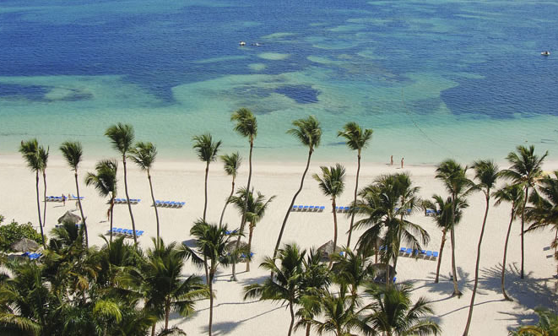
Thank you for your attention
Contacts:
Donald Pols (pols@ecn.nl)
James Falzon (falzon@ecn.nl)
Nguyen Thi Dieu Trinh (trinh4mpi@gmail.com)

