Slide 1

Methods and tools for assessing poverty reduction benefits
The Center for Climate Strategies and Grantham Research Institute
LEDS GP
October 14, 2015

Slide 2
1. Introduction and approach
Context, goals, techniques

Slide 3
Session Overview
CONTEXT
CONCEPTS
TECHNIQUES
COUNTRY EXAMPLE
TABLE DISCUSSIONS
TABLE DISCUSSIONS

Slide 4
Context
Economic hardship
Local and global recession
Divisions within government, lack of national vision
Distraction with other priorities
Limitations on capacity and knowledge

Slide 5
Goals
Create upward spiral
Avoid downward spiral

Slide 6
Ingredients
Improve income
Improve employment
Target distribution
Reduce Poverty

Slide 7
Upward Spiral
Sustainable growth, income, jobs
Controllable costs, prices
Evolution from primary to secondary, tertiary production
Imports to exports
Reduced secondary or hidden costs
Creation of value and influx of currency
Targeted, reliable reinvestment
Fewer divisions of wealth, better middle class

Slide 8
Concepts
Economic, energy, environment, equity (E4) are linked
Policy actions and jobs/income are linked
Policies can be chosen and designed to improve economic conditions
Policies can be tested quantifiably
Not all policy actions or designs perform well
Distribution of costs/benefits is a driver

Slide 9
Macroeconomic Strategies
Cost effective approaches increase economic efficiency and expansion
Energy savings cut energy costs, stimulate labor investment
Shifts to indigenous vs. imported resources cut job outflows
Actions supported by local supply chains cut job outflows
New investment from outside sources stimulates labor investment at home
Labor intensive activities create more jobs, even if at higher cost (up to a point)

Slide 10
Macroeconomic Strategies
• Policies that reduce cost or improve efficiency directly for those with low incomes or spending power
    Reducing the amount of spending necessary to achieve basic needs: ”income effect"
    Avoiding significant financing barriers or up-front costs borne directly those who are poor.
Policies that spend on less-skilled labor to execute some other goal: employment effect
Policies that do both: Engage labor and reduce costs (eg. plant trees around homes
Efficiency policies with indirect benefits to poverty alleviation:

Slide 11
Evidence of Success
Country examples…

Slide 12
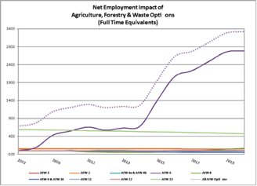
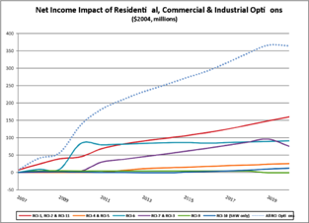
USA State, by Sectors/Options
Jobs, Agriculture
Income, Energy Efficiency

Slide 13
Opportunities for Labor Markets
‘Green jobs’
Switch to more labour-intensive technologies and processes
More aggregate demand
More innovation
Co-benefits, especially better health: good for welfare, labour supply, cognitive development
Reduced labor taxes

Slide 14
Key Issues for Labor Market Analysis
‘Green jobs’ difficult to define
Much scope for gross job creation in the transition to green growth
But policy-makers seeking co-benefits should focus on net job creation
Studies for high-income countries not necessarily a good guide for developing countries
Economy-wide macro responses (e.g. impact on general level of wages) need to be understood

Slide 15
Opportunities for job creation:
Uncertainties e.g. India – wind energy
Source: TERI (2010)

Slide 16
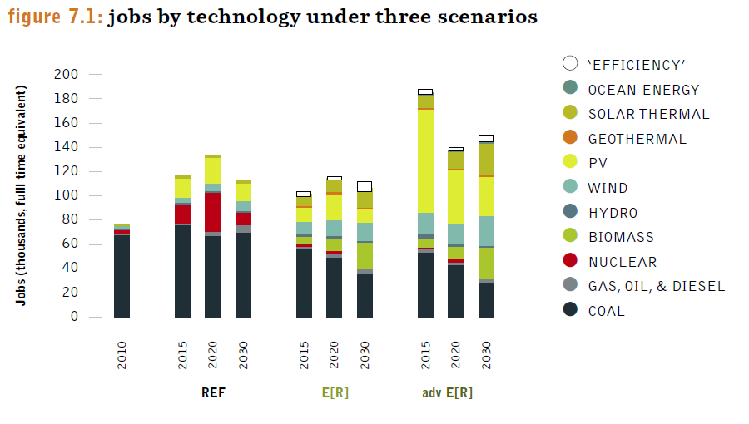
Opportunities for Job Creation:
Net vs. Gross e.g. South Africa
Source: Rutovitz (2011)

Slide 17
Challenges for Labor Markets
‘Brown jobs’
Higher production costs
Lower real wages?
Skill bottlenecks
Need for good government and well-designed, credible policies for the environment, skill development, innovation and fairness
Active labor market policies

Slide 18
Action Plan Process
Step 1
Step 2
Step 3
Step 4
Step 6
Step 7
Step 8
Step 9
Step 10
Organization and Goals
Step 5
Baseline Development
Policy Options Identification
Policy Screening & Prioritization
Initial Policy Design Specifications
Direct (Micro) Impacts Assessment
Policy Options Integration and Overlap
Indirect (Macro) Impacts Assessment
Final Recommendations & Report Transmittal
Monitoring, Reporting, Evaluation, & Updating

Slide 19
Techniques
Policy Option Identification (catalogs, databases)
Policy Option Screening (MCA)
Policy Option Design (specific parameters)
Micro Analysis of Options (direct impacts)
Integration of micro impacts
Macro Analysis of Options (indirect impacts)
Setting goals
Baseline Development
Notes:
Assume baselines and catalogs are in place, integration occurs after micro, and iteration is used to reach agreement

Slide 20
Comprehensive Baselines
Inventory and forecast
Energy, environment, economy, equity (E4)
Environment = GHG emissions and underlying resource uses, potentially other impacts (air, water)
Need to understand E4 drivers and trends

Slide 21
Poverty Metrics
Macroeconomic
  Per capita income
  Employment
  Economic growth
  Prices
Equity
  Breakdowns by income, age, gender, social strata, location, vocation, business size/class, etc.
  Distribution

Slide 22
Policy Options
Full range of potential policies and measures within and across sectors
Relevant to goals, policy action, and place
Examples from existing programs
Enhancements and innovations
Inside and outside jurisdiction
Winning strategies for poverty reduction

Slide 23
Table Discussion/Exercise 1
How would poverty reduction be incorporated into each of these initial steps for LEDS in your country?
  National vision?
  Agency priorities?
  Leadership commitments in agencies and above?
  Interagency planning mechanisms?
  Baselines?
  Existing building block policies related to LEDS?
  Scoping of new LEDS options?
  Stakeholder awareness of LEDS/green growth actions?
  Tools for micro and macroeconomic analysis and planning?

Slide 24
2. Option screening and design
Multi Criteria Analysis, Macroeconomic Design of Options

Slide 25
Screening and Design Process
List policy options for each sector
Selection criteria for selecting draft priorities
Benchmark or use expert judgments
Revise the list as needed
Conduct group balloting
Separate to top tier, second and third tiers

Slide 26
US State Example
Economic
GHG Cuts Now and Later
$ Total Costs
Cost Effectiveness $/GHGs Cut
Jobs, Income, and or Growth
New Markets and Investments
Diversity and or Independence
Reliability Now and or Later
Access and or Affordability
Health – Air Quality, Water Quality, Other
Land, Water, Wildlife Conservation
Income
Technical, Market, Program, Legal
Social/Political
Energy
Environment
Equity
Feasibility
Complexity, Ease of Technical Analysis
Age
Place
Ethnicity

Slide 27
MCA Setup
Minnesota Climate Solutions and Economic Opportunities (CSEO) Project | Decision Criteria ➤ | Complexity, Ease of Technical Analysis | GHG Cuts Now and or Later | $ Total Costs | Cost Effectiveness -- $/GHGs Cut | Jobs, Income, and or Growth | New Markets and or Investments | Energy Diversity and or Independence | Energy Reliability Now and or Later | Energy Acces and or Affordability | Health -- AQ, WQ, or Other | Land, Water, and or Wildlife Conservation | Equity -- Income, Age, Place, and or Ethnicity | Feasibility -- Technical, Market, Program, Legal | Feasibilty -- Social/Political | # Ballots | Priority Ranking
2008 Options | Ranking Scheme ➤ | H, M, L, U, or a range/combination | H, M, L, U, or a range/combination | H, M, L, U, or a range/combination | H, M, L, U, or a range/combination | H, M, L, U, or a range/combination | H, M, L, U, or a range/combination | H, M, L, U, or a range/combination | H, M, L, U, or a range/combination | H, M, L, U, or a range/combination | H, M, L, U, or a range/combination | H, M, L, U, or a range/combination | H, M, L, U, or a range/combination | H, M, L, U, or a range/combination | H, M, L, U, or a range/combination | 10 Ballots/Voter, 1 For Each Preference | Tiers 1, 2, 3
Option #, Sector | Ranking Scale ➤ Policy Option Description ↴ | H = x... to y... (+/-) M = x... to y... (+/-) L = x… to y... (+/-) | H = x to y... (+/-) M = x to y... (+/-) L = x to y... (+/-) | H = x to y... (+/-) M = x to y... (+/-) L = x to y... (+/-) | H = x to y... (+/-) M = x to y... (+/-) L = x to y... (+/-) | H = x to y... (+/-) M = x to y... (+/-) L = x to y... (+/-) | H = x to y... (+/-) M = x to y... (+/-) L = x to y... (+/-) | H = x to y... (+/-) M = x to y... (+/-) L = x to y... (+/-) | H = x to y... (+/-) M = x to y... (+/-) L = x to y... (+/-) | H = x to y... (+/-) M = x to y... (+/-) L = x to y... (+/-) | H = x to y... (+/-) M = x to y... (+/-) L = x to y... (+/-) | H = x to y... (+/-) M = x to y... (+/-) L = x to y... (+/-) | H = x to y... (+/-) M = x to y... (+/-) L = x to y... (+/-) | H = x to y... (+/-) M = x to y... (+/-) L = x to y... (+/-) | H = x to y... (+/-) M = x to y... (+/-) L = x to y... (+/-)
ES 3 | Efficiency Improvements, Repowering and Up Grades to Existing Plants
ES | Increase RES
ES | Increase Solar Standard
ES/RCII | 111(d) Scenario (Including Price and Non-Price Mechanisms)

Slide 28
Policy Option Comparison

Slide 29
MCA Results, US State

Slide 30
Table Discussion/Exercise 2
Apply Poverty Reduction to MCA Screening
  Which Poverty reduction decision criteria would you use?
  Which Benchmark sources?
  Which Expert ranking/rating?

Slide 31
Policy Option Design
Timing
Level of effort
Coverage of parties
Eligibility and definitions
Type of mechanism(s)
Sources and uses of funds

Slide 32
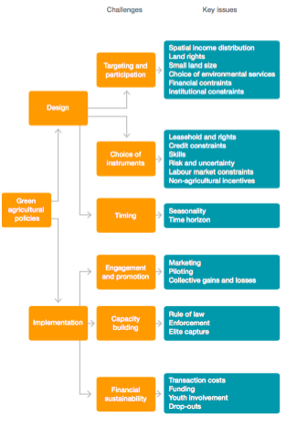
Example
Making Green Agricultural Policies Effective in Reducing Poverty
Source: Lovo et al. (2015): Green agricultural policies and poverty reduction,
GRI Policy Brief, London: LSE

Slide 33
3. Analysis of policy options
Micro, Integrative, Macro

Slide 34
Progression
Baselines
Micro
Integration
Macro
Distribution

Slide 35
Micro Analysis Set Up
Principles and guidelines
Common assumptions for all sectors and each sector
End user needs
Capacity constraints
Templates and tools
  Linked system (Baselines, options, micro, integration, macro)
  Customized policy option analysis
  Methods, Data Sources, Assumptions
  Toolkit

Slide 36
NPV Example

Slide 37
Integration
Initial micro-economic analysis of each policy is done on a “stand-alone” basis.
This assumes policy implementation all by itself with results calculated against business as usual (BAU) conditions.
There are both intra-sector and inter-sector overlaps/ interactions to address
Reduce the possibility of “double-counting”

Slide 38
Macro Overview
  How will people, business, government respond to direct costs and savings?
Key Questions:
  Change in spending: How is other spending affected? (Reallocation)
  Change in spending: A change in demand, or a change in price?
  Change in taxes: How will government spend that tax money?
  Identities: Who is spending money? Who is saving? Who is selling more? Who is selling less?
  Where is money for infrastructure coming from? Is it displacing other investment?
  Import/Export: Are goods/services/investment entering or leaving?

Slide 39
Macro Metrics
Macroeconomic
  Growth, income, employment
  Prices, productivity
Fiscal
  Spending, savings, allocations, levels
  Sources and uses of funds, budgets
Equity
  Distribution across special populations

Slide 40
Macro Models
Software that models flows of money around the economy, changes to productivity, output, inflation, incomes, employment
Models of different types (REMI, CGE, I-O)
Data must reflect a specific economy with specific:
  Labor productivity
  Intermediate demand for each sector
  Elasticities of demand
  Costs for goods and services
  Levels of activity in different sectors
  And Many Other Unique Characteristics!

Slide 41
Equity/Poverty Impacts
Comparative levels
Absolute levels
Person and household: age, gender, location, health, wealth, role, social status, special factors
Community: location, cultural factors, social status, sustainability, wealth, role, special factors
Business: size, role, location, age, sustainability, special factors

Slide 42
Final Results
Transmittal to leadership
Next steps

Slide 43
Country Example
Democratic Republic of Congo
Trinto Mugangu, PhD
DRC Coordinator for Low Emission Development Strategies & Climate Change Negotiator for GHG Mitigation
DRC Ministry of the Environment & Sustainable Development

Slide 44
DRC
Issues:
Dependence on fossil fuel, and unsustainable use of Earth’s resources.
More than 70% of DRC population of 71millions live with less than one dollar a day, and unemployment rates are among the highest in the world.
A History of Plunder and Corruption
Potentials:
  Rain forests storage potential
  Mineral richness
  River system and freshwater
  Hydro-electric potential
  Increased education

Slide 45
DRC: National Vision
Economic emergent status by 2030.
Hinged on rapid development and industrialization as a means to put to work 71 millions people, and to use its abundant and diversified natural resources
DRC leadership is open and supportive
Challenges:
  Skills
  Management
  Education
  Policy and investment
  Access to appropriate technology
  Domestic production base limitation, and domestic cooperation
  International understanding of DRC needs

Slide 46
DRC: National Vision
Key objectives:
Create a labor pool of intelligence and know how
Create a middle class of entrepreneurs
Make DRC an agricultural success
Transform DRC to an energetic and environmental power with sustainable multiple use management of forests
Make DRC an economic and industrial pool
Make DRC a land of peace, stability and prosperity, and a land of wellness with clean air and good health
Make DRC a regional environmental & economic power to catalyze Africa’s development

Slide 47
Thank you for your time and attention!
QUESTIONS ?
Center for Climate Strategies
1800 K Street NW, Suite 714
Washington, DC 20006
www.climatestrategies.us
Thomas D. Peterson
tpeterson@climatestrategies.us

