Slide 1
Sitting many diverse people at the table to tackle complex issues
Hernán Blanco, Michelle du Toit
14 october 2015

Slide 2
Who we are
Most of the time we are here
To get to know and understand the other (who I am)
Conversations about roles (what I do)
Requests, promises: most conversations here (what we do together)
3. Coordinate action
Natural order
2. Explore posibilities
1. Build a relationship
Do we take time to get to know who we are? A fundamental step in every trust-building relationship!

Slide 3
A brief exercise to get to know one another
It does not hurt to start our gatherings with some kind of playful conversation/interaction. We relax and feel we can take part and a sense of group might start building up.

Slide 4
This Session
Introduction and your objectives/expectations
Why stakeholder engagement – the case of MAPS Programme
How – main steps in designing and implementing a participatory process
Q&A
Evaluation
WHY and WHAT stakeholder engagement?
Main STEPS in designing and implementing a stakeholder engagement process (for LEDS)
It is crucial that we know what is it that we want to do together (expectations) and that we are flexible to accomodate other contents / emphasis.
Some methods and tools for stakholder engagement

Slide 5
Your objectives / expectations (for this session)
This is a central issue in construcive participation, conflict prevention and management!
Why have stakeholder engagement in LEDS?
What would you like to achieve today? Themes you would like to cover?

Slide 6
Rules of the game?
We learn by doing, by experiencing
We as facilitators (more than lecturers); your experience is central
Mobiles, computers… screens!
Participation – order in interventions
Notes, minutes…
Confidentiality?
Hierarchies
¿Others?
Do we identify and AGREE on rules of the game at the very beginning of our processes?

Slide 7
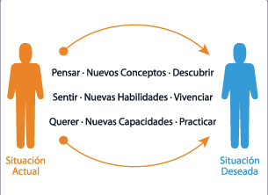
Before continuing – what are our relevant beliefs (paradigms)?
Are we aware and respectful of our believes (principles, values) – mine and the others’?

Slide 8
A bit of context

Slide 9
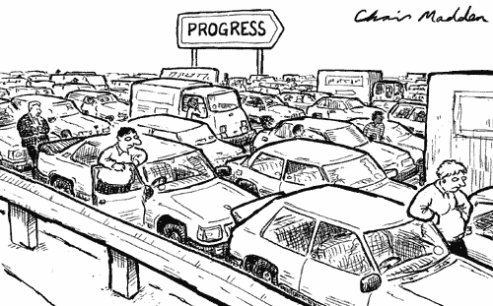

Slide 11
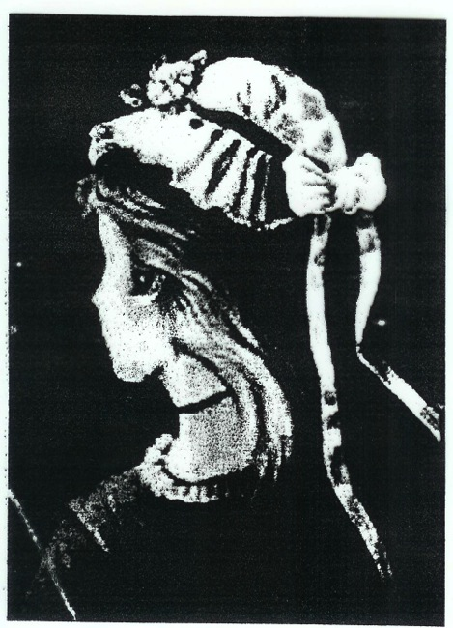

Slide 12
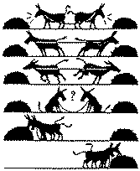

Slide 13
Why and what stakeholder engagement
The case of MAPS Programme

Slide 14
Stakeholder engagement in knowledge creation: MAPS experience
LEDS GP October 2015
Punta Cana

Slide 15
The MAPS Community
SOUTH SOUTH COLLABORATION
COUNTRY TEAMS
MAPS INTERNATIONAL
SOUTHERN EXPERTS
Notes:
Donor support – CIFF, SDC, CDKN,

Slide 16
MAPS Programme
Collaborative Programme Global South
Generate & share knowledge, ways of working and ideas
Strong focus on country leadership and sovereignty
Local circumstance and needs paramount
A general approach versus imposing a strict methodology:
different ways of approaching stakeholder engagement and structure of process between the countries according to the government needs, goals, way country is structured
collaboration and cross pollination between countries = evolving way of doing things

Slide 17
Generation of knowledge
The generation of relevant knowledge is useful and needed to inform policy decisions
So how to produce this in the best way:
Co-creation of knowledge: buy-in, ownership, rigour
Having the right people in the room
Rules of the game: structure and trust
Conflict: the real conversations
Impartial facilitator to lead the discussions
The Journey is the Destination
Credible and Relevant evidence and options to policy makers

Slide 18
MAPS Process
Governmental Steering Committee (mandate)
Research Team
Facilitation
REPORT
FINAL REPORT
Stakeholder Team: Industry, Government, Civil Society
Government
High-Level Stakeholders
Process design differs from country to country to accommodate national circumstances & culture.

Slide 19
Form of Stakeholder engagement
Steering committees (government)
Executive commitees
Scenario building teams (industry, government, civil society)
Technical working groups (industry, government, civil society)
Consultants
Mitigation actions
MAC curves
Co-benefits /co-impacts
Baseline scenarios
Mitigation scenarios
Required by science scenario
Required by equity scenario
Macroeconomic modelling
Knowledge management platforms

Slide 20
MAPS Approach
Country specific, responsive not prescriptive
APPROACH NOT METHODOLOGY
Multi-ministerial mandate, legitimate
COUNTRY LED
Country: stakeholders, researchers. Collaboration: input
CO-PRODUCTION OF KNOWLEDGE
Consultative, multiple viewpoints, relevance
FACILITATED PROCESS
Local researchers, development focus, credible
SOUTHERN COMMUNITY
Capacity building within country and community
COLLABORATION & SUPPORT
Informed targets and decisions. More viable implementation, achievable targets.
EVIDENCE
Evolving best practice, learning by doing, out the box
INNOVATION
Notes:
Not a strict methodological approach rather a collaborative space
Collaborative, collegial space that offers support, capacity building when necessary, innovation
Process Design and research differs from country to country to accommodate national circumstances & culture
Legitimacy, credibility, relevance
To record an evolving best practice, providing impetus to implementation of climate change mitigation action in developing countries

Slide 21
Thank You
www.mapsprogramme.org
Who Supports MAPS

Slide 22
Steps in a stakeholder engagement process

Slide 23
Main Steps
Getting a mandate
Building up a team
Defining and implementing governance structure
Identifying and gathering stakeholders
Rules of the game
Designing a process
Preventing and managing conflicts
Evaluating

Slide 24
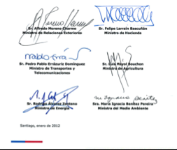
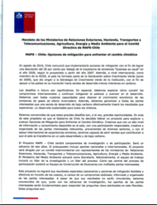
Mandate
Why? What for?
How?
Who?
There must be a high-level demand –sense of ownership– of what we are doing and of the eventual results.

Slide 25
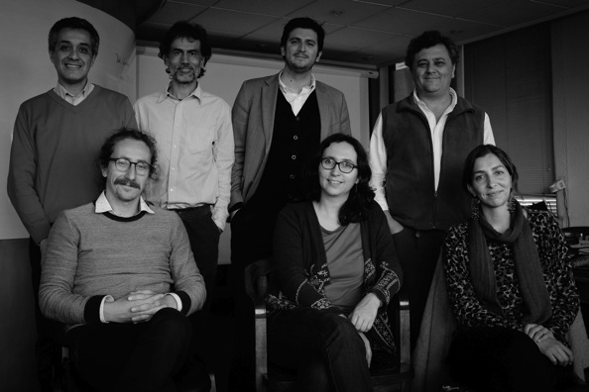
Building up a team
We cannot give what we don’t have…
There is an undeniable relationship between the “micro” and the “macro”.
It is fundamental to have a good “team spirit” with a reasonable capacity to prevent and manage internal conflicts.

Slide 26
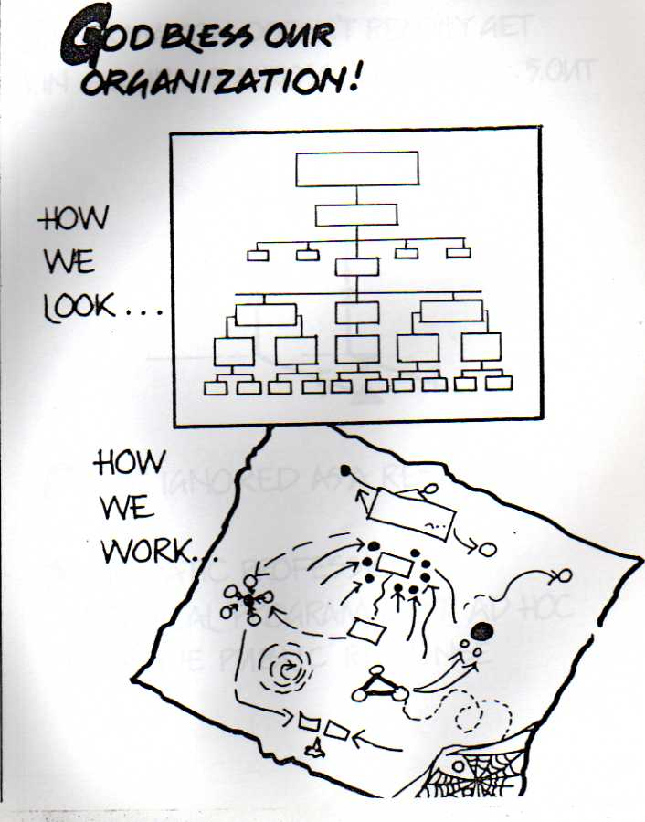

Slide 27
Governance
Many actors
Most of the time poor inter-institutional coordination/communication
Competition; not good history of cross-ministerial collaboration
Anticipate issues; eg change in Administration…
Governance must be agreed upon as early as possible with all main actors. Roles have to be as explicit as possible.

Slide 28
Final decisions
Inter-ministerial steering committee
14 people from 7 Ministries
Suggestions and inputs for decisions
Scenario building team
60 people from public, private, academic, NGOs and consultants.
SC and professional team also part of the SBT.
Information, data inputs and sectoral experience
Technical working groups
40 people from each sector invited to technical meetings: electricity, transportation, industry and mining, CPR, wastes, forest, agriculture and livestock
Sectoral modelling
Sectoral consultants
6 consultant teams, over 50 people altogether
Design, analysis, review, coordination
Professional team MAPS Chile
14 professionals from different backgrounds
MAPS Chile
Multiple iterations

Slide 29
Stakeholders
Who in the room – selection
Who decides
Criteria; various ways
Who invites
What “format”: advisory group, expert group, technical groups, steering committee…
Many challenges: people not in the room; trust; competing interests, costs / payments?, etc.
Civil society participation
Personal contact with each participant is important right from the beginning; each of them need to have a perception that there are concrete benefits of participating.

Slide 30
Exercise
For the selected LEDS initiatives, in your table:
Identify a list of key stakeholder groups
Think of possible risks of involving each group in the context of the LEDS initiative under analysis
List this in a table
15 min

Slide 31
Rules of the game
To define roles, rights and duties
To anticipate complicated issues and ways forward
Examples: membership, decision-making, the media, confidentiality, publications, etc.
In MAPS Chile we had rules of the game defined and agreed for:
Steering committee
Scenario building team
Technical working groups
Important that all actors know the rules of the game, and ideally approve them.

Slide 32
Designing a process…
A good blend of information/data (thinking), interactions (feeling) and procedures (will).
A sense of rhythm (frequency)
Process must be designed collectively by research and process teams: process has to be at the service of the research and vice versa.
We need to combine an important effort to have a comprehensive plan/design with a flexible attitude to modify it as required. In this sense, the design has to be “organic”.

Slide 33
Preventing and managing conflicts
Differences and conflicts
thinking
Aspect | Excess | Lack
Contents Quality of ideas and information
Interaction Capacity to cooperate and listen
Procedure Ordered, chaotic
feeling
willing

Slide 34
Preventing and managing conflicts
Differences and conflicts
thinking
Aspect | Excess | Lack
Contents Quality of ideas and information | Trees don’t let us see the forest | Speculation, arbitrarity, lack of credibility
Interaction Capacity to cooperate and listen | Emociones desbordadas, excesiva polaridad, ineficiencia | Not alive, poor creativity
Procedure Ordered, chaotic | Rígido, hiper sistemático, inflexible, bureocrático | Without direction; going in circles
feeling
willing

Slide 35
Barriers to constructive participation and conflict prevention/management – our distorted perceptions

Slide 36
Quick exercise

Slide 37
Evaluating
How was the information/data, the contents
How was the interaction, the relationships
How were the procedures, methods and tools used
Evaluation should be done at all levels and right from the beginning (no need to wait until the end!).

Slide 38
In essence what is it that we are doing…
A Process
of Change
How do we change?
What are our essential human faculties crucial in processes of change?
Gradual
Organized
Transparent
Informed
Creative
Respectful
Inclusive
Our thinking: contents, data (information)
Our feeling: interaction, relationships (values)
Our will: procedures (interests)
A perception must exist that we give AND receive something valuable… a trust-building relationship

