Slide 1
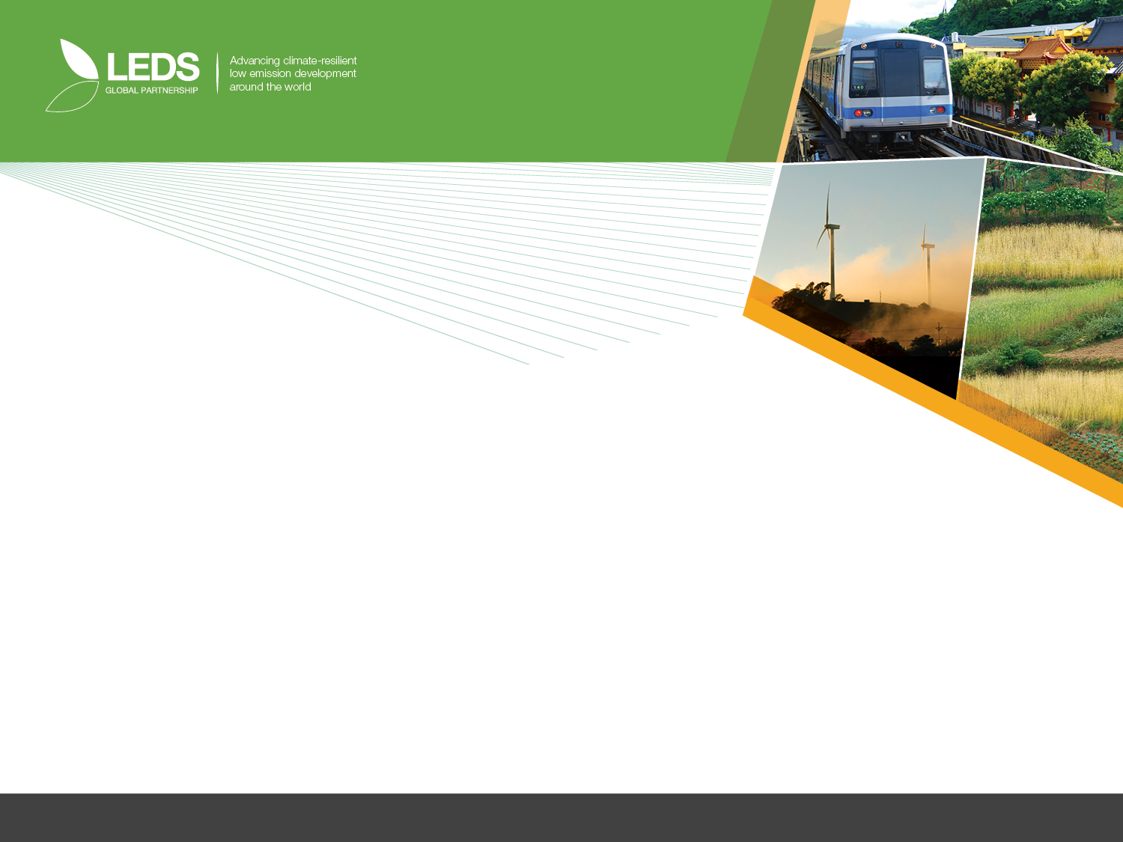
Training Session 3: Financial instruments and innovative risk mitigation instruments
Please join the LEDS GP and encourage others to join.
www.ledsgp.org

Slide 2
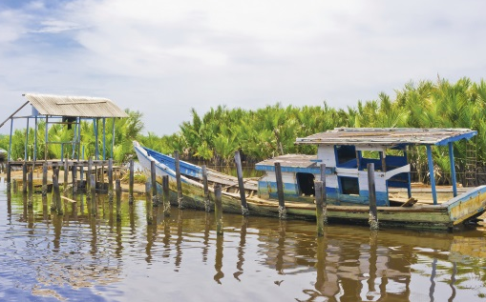
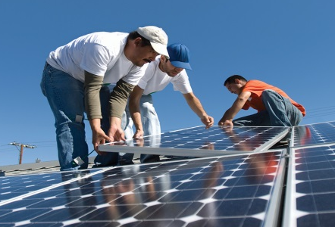
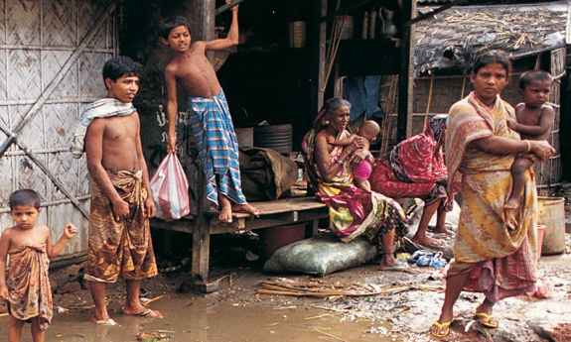

Financial Instruments &
Innovative Risk Mitigation Instruments for Climate Financing
Alan Miller, USAID/CEADIR (Crown Regents USA)
Michèle Laird, USAID/CEADIR (Abt Associates Inc.)
October 14, 2015 • LEDS GP Annual Conference

Slide 3
Agenda
Welcome
Michèle Laird and Alan Miller, USAID CEADIR
Overview of private climate finance and public incentives
Michèle Laird and Alan Miller, USAID CEADIR
Innovative Instrument Case Study: Energy Savings Insurance
Asger Garnak, IADB and Daniel Magallon, BASE
Table Discussions
All Participants
Report out and questions

Slide 4

Put your hands in the air

Slide 5

PUT YOUR HANDS IN THE AIR!!

Slide 6
QUESTION 1
IS THERE ENOUGH MONEY IN THE WORLD TO FINANCE CLIMATE CHANGE MITIGATION AND ADAPTATION?

Slide 7
ANSWER 1
YES!

Slide 8
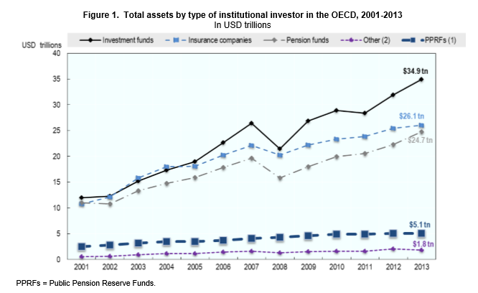
Where is the money?
There is no shortage of finance in the world . Indeed there are almost 100 trillion US dollars in managed assets

Slide 9
QUESTION 2
IS ENOUGH MONEY CURRENTLY FLOWING TO CLIMATE CHANGE MITIGATION AND ADAPTATION PROJECTS IN DEVELOPING COUNTRIES?

Slide 10
ANSWER 2
NO!

Slide 11
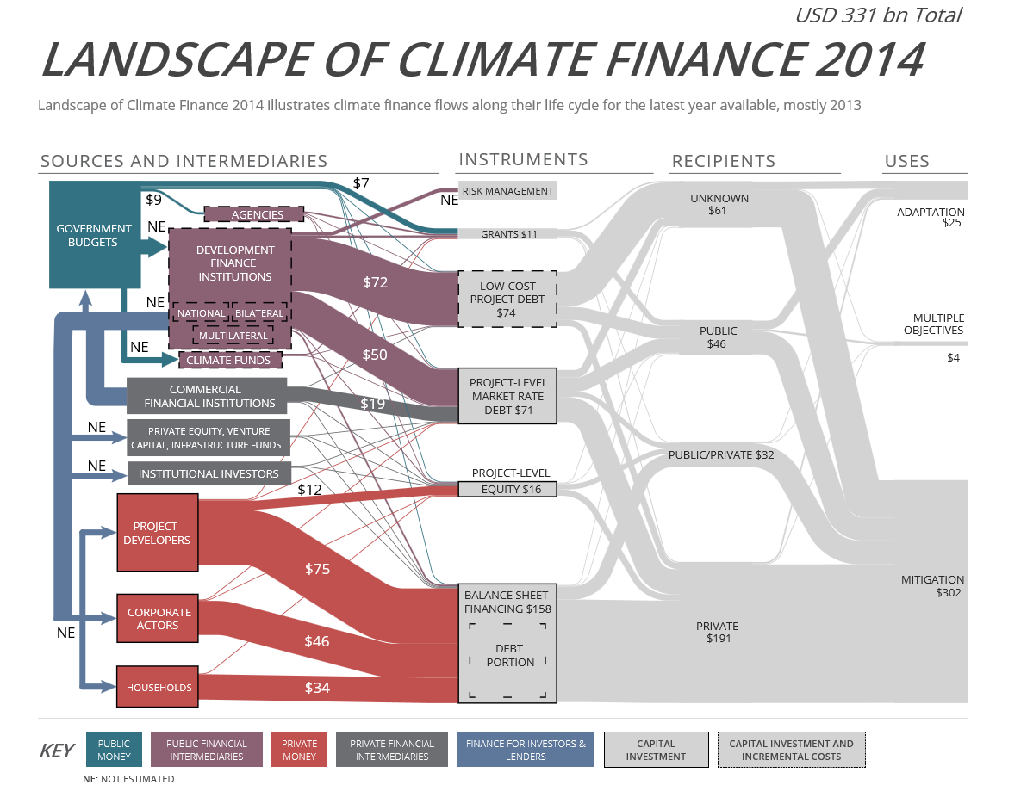
Only a small portion is reaching climate investments

Slide 12
So then, what’s the problem?
A very small amount is currently directed to “climate friendly” or “green” investments
Absence of funding for activities can be for many reasons but it is rarely due to and absolute lack of financial resources.
There are trillions of dollars of private capital seeking investment opportunities.
But … private investors are seeking not just any investment opportunity, but the right one.

Slide 13
QUESTION 3
SO, WHAT ARE PRIVATE INVESTORS LOOKING FOR?

Slide 14
ANSWER 3
IT DEPENDS….

Slide 15
Nature of private finance
The private financial landscape is complex and diverse:
Private finance is provided by a wide range of actors and through a variety of channels.
It features different levels of risk and return expectations.
It features varying levels of liquidity.
It involves different actors ranging from small angel investors to very large banks and institutional investors.
It can be short-, medium- or long-term.

Slide 16
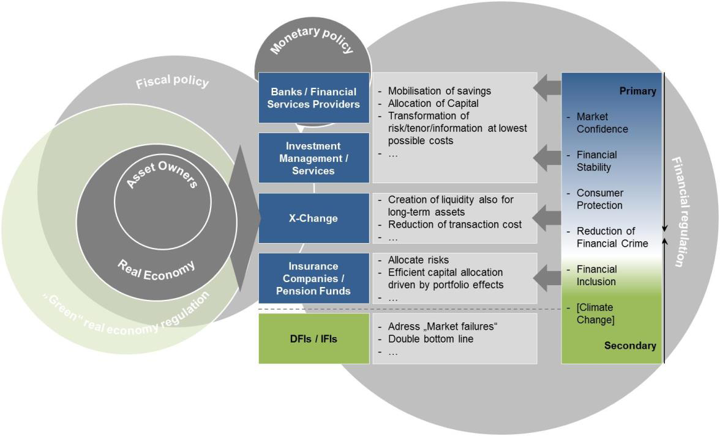
Snapshot of financial market players

Slide 17
Individual transactions
Individual private transactions can be described and differentiated by reference to the following six dimensions:
Individual private transactions can be described and differentiated by reference to the following six dimensions:
Legal nature of the financial transaction.
Transaction seniority and associated risk profile.
Channel and intermediary actors through which the flow of finance is arranged.
Term or tenure of the financial arrangement -- closely linked to the liquidity of the financial asset.
Source and origin of the financial resource
Use of proceeds related to the transaction.

Slide 18
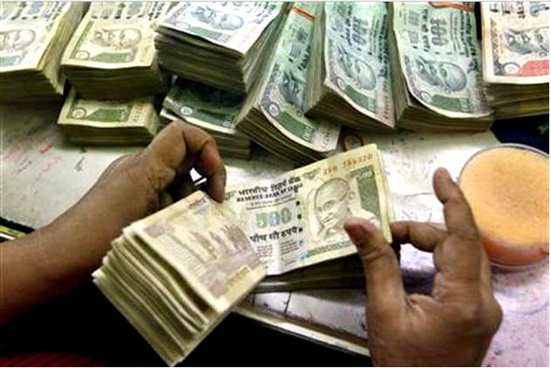
Boiling it down
At heart: appropriate risk-adjusted returns for the providers of these funds.
The greater the risk (or the greater the perception of that risk), the greater the returns that will be expected
The language of risk and returns -- financial and investment decisions are primarily a balancing of financial costs and returns.
In practice, however, a much broader variety of nationally specific factors – only some of which can be readily described in financial terms -- affect financial decisions and ultimately the nature and direction of financial flows.

Slide 19
Barriers to mobilizing private finance
Barriers to mobilizing private finance for climate change related mitigation/adaptation in developing countries are often those common to any private finance in the country:
  instability of legal, economic, and regulatory frameworks within which private sector activity unfolds,
  shortcomings in the reliability and longevity of regulatory schemes linked to project returns,
  the commercial viability, bankability, and/or creditworthiness of the project or venture at hand.
  Or, factors commonly referred to as indicators of the investment climate

Slide 20
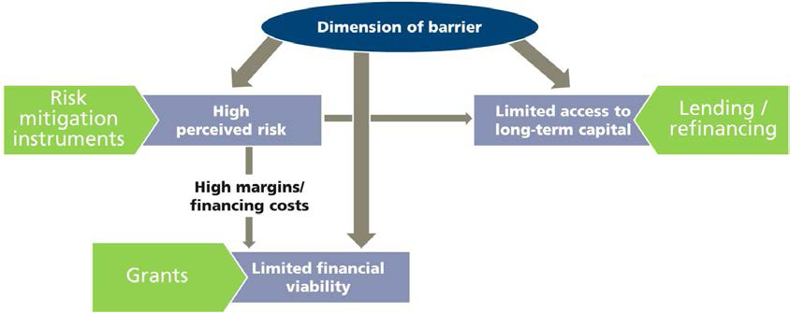
Public finance mechanisms can overcome barriers
Risk mitigation instruments can address high (perceived) risk.
Direct investments by Development Finance Institutions (DFIs) / International Finance Institutions (IFIs) can supply additional long-term capital
Grants can address gaps in the financial viability.

Slide 21
Overview of PFI instruments to support climate change projects
Risk | Functions | Tools and Instruments
Facilitate access to capital | Providing long-term capital Facilitating access to private capital | Concessional and non-concessional lending Equity investment International climate funds Public-private partnerships
Reduce risk | Risk-sharing Credit enhancement mechanisms | Structured finance: Guarantees Public-private partnerships Junior debt/Mezzanine financing Insurance products (e.g. political risk insurance) – complex to deploy
Fill the capacity gap | Aiding project development Reducing project risks | Technical assistance Capacity building Information tools (GHG quantification, energy certificate tracking, etc.)

Slide 22
All climate change projects are not the same
Each type climate change-related project has unique issues and challenges in attracting private finance.
Private financial requirements vary by project types; each project type is likely to confront obstacles specific to its financing needs.
Public intervention to move different types of climate change related projects forward similarly varies
Thus, effective use of climate finance to bring about private investment depends on understanding
  which issues are most relevant
  for a specific project or strategy
  in a given market
  at a particular time

Slide 23
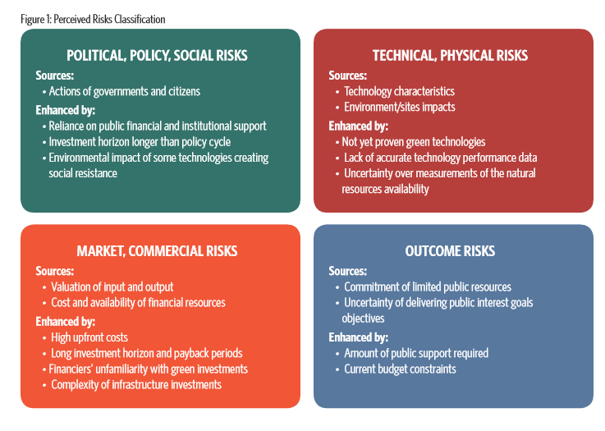
Perceived risks

Slide 24
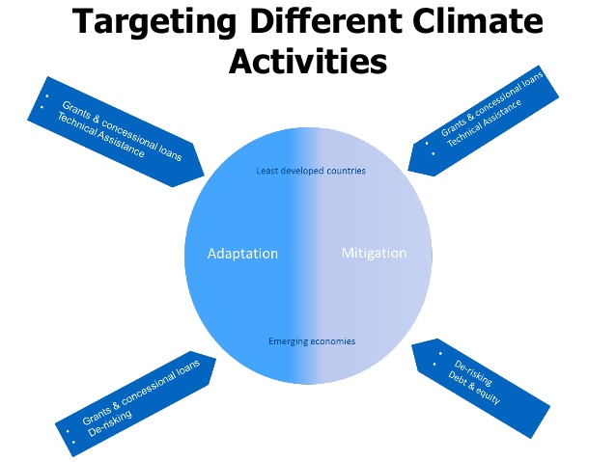
Different instruments for different activities

Slide 25
Blending of financial sources and policy instruments necessary
Private investments
Policies and Regulations;
Incentives for Barrier Removal
Technical Assistance;
Capacity Development
Carbon finance
Support for R&D
Development Financing
Public financing
Project needs to be financially solid to be able to deliver real, measurable
and long-term benefits related to the mitigation of or adaptation to climate change
Notes:
Enabling environment is crucial both generally and for individual programs/projects.
It is analytically elegant to portray one instrument or financial vehicle for one project, but it is important to recognize that reality is more complex. More and more, we focus on building synergies between different instruments to reach financial closure and make project and program ideas a reality - and this is true for different technologies: from efficient lighting programs to wind farms.
Current initiatives targeting REDD illustrates how a mix of instruments is required to steer a transformation of behaviors and investment decisions: a combination of upfront finance (concessional and innovative finance -- notably through FIP) and performance-based incentives (FCPF) are needed to promote policy reforms, build capacity, and undertake investment programs. The example also highlights the crucial role of public finance as a catalyst for climate action.
The Senegal Rural Energy Efficient Lighting program combines an IBRD loan for rural electrification with carbon finance for demand-side energy efficiency. Both go hand in hand.
It is important to recognize the opportunities for building synergies between different financial instruments. “Blending” is critical to leveraging maximum mitigation potential.

Slide 26
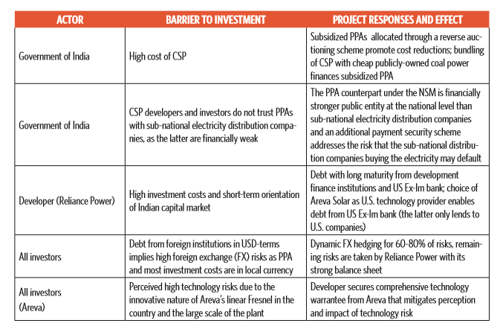
Example of public and private sector together financing climate change project: Concentrating Solar Power (CSP)

Slide 27
Example: Menengai Geothermal Development Project
Kenya recognized that investors are reluctant to take geothermal exploration risk (and if investors take the risk, tariff becomes high). So, given country’s well-developed energy policy, including feed-in tariffs, Kenya established the Geothermal Development Company (GDC) which is responsible for the developing geothermal fields, in specific steam production – which the private sector will subsequently use to produce electricity.
For GDC’s development of the Menengai Field, the government of Kenya provided USD 247 m while the African Development Fund provided USD 125m blended with USD 25m from the Scaling-up Renewable Energy Program – one of the Climate Investment Funds – alongside other IFI funding (AFD USD 72 m, EIB USD 38 m, IDA being finalized).
This investment in drilling and steam production laid the foundation for private sector investment in (Independent Power Producers) IPPs. Three 35 MW plants are being financed, designed, built, installed, operated and maintained on a build-own-operate basis by three IPPs. Additional projects planned.
African Development Fund approved USD 12.7 m Partial Risk Guarantees to ease investor risk for initial part of project. PRG is for first 105 MW electricity produced by plants operated by three IPPs, to provide investors with comfort on the steam supply by GDC to the IPPs under the aegis of the steam supply agreements.

Slide 28
Example: USAID CEADIR and Climate Bonds
  Climate/green bonds created to fund projects that have positive environmental and/or climate benefits.
  Green bonds are standard bonds with “green” or “climate” as a bonus
    Proceeds earmarked for climate or environmental projects
    Labelled as ‘green’ by the issuer
  Majority of the green bonds issued are green “use of proceeds” or asset-linked bonds - proceeds are earmarked for green projects but are backed by the issuer’s entire balance sheet.
  Other types include: green "use of proceeds“ revenue bonds; green project bonds; green securitized bonds
  USAID/CEADIR is working with countries to facilitate issuance of green bonds by PFIs, sometimes with additional of partial guarantee, as means to attract private sector finance

Slide 29
Climate/Green bonds address funding challenges
Long term debt
Address asset liability mismatch
Re-finance construction and long term loans
Climate Bonds
Fund RE Projects
Fixed interest, long tenor
Improve liquidity
Funding across project cycle
Low cost funds
Priority area for green investments
Lower cost, fixed interest, longer tenure, and non-recourse options of financing for borrowers
Rapid increase in corporate issuances
Alternate market for funding RE
List on alternate investment markets
Bilateral trade uses risk mitigated, ring fenced structures

Slide 30
Innovative Instrument Case Study
Energy Savings Insurance

Slide 31

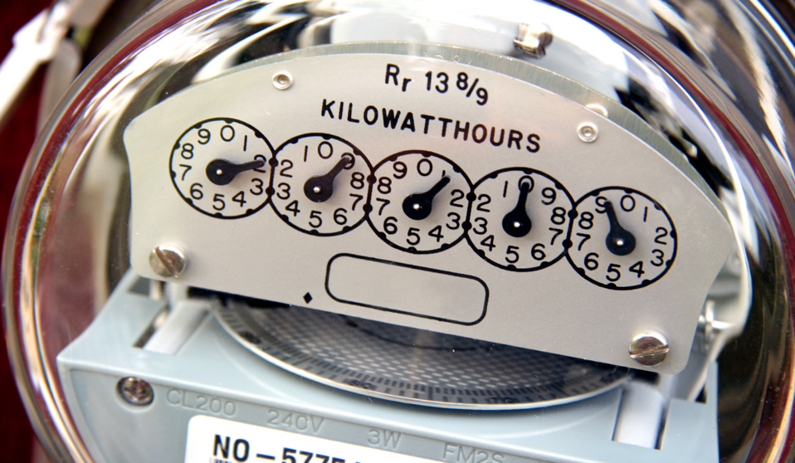


Energy Savings Insurance
INTER-AMERICAN
DEVELOPMENT BANK
TOPIC TO BE DISCUSSED

Slide 32

1.Rationale for EE investments. Risks and barriers
2. The Energy Savings Insurance approach
3. ESI in action. How to introduce it, case studies
4. How to implement the mechanism in your country?
Notes:
1.Rationale - we introduce the:
Potential EE Market
Benefits of EE
Barriers and risks
2. The Energy Savings Insurance toolkit – we will present a step by step approach to address the barriers and implement the required mechanism
3. We give examples about ESI in action
Case studies - Piloting efforts in LAC Countries (Mex, Col)
Innovation Lab and Danish gov. contribution
We Breakout in groups to discuss on how to implement the mechanism in your country

Slide 33

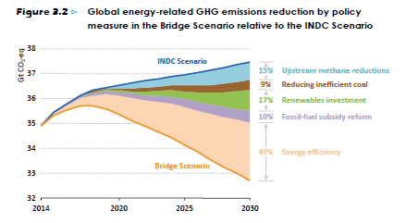
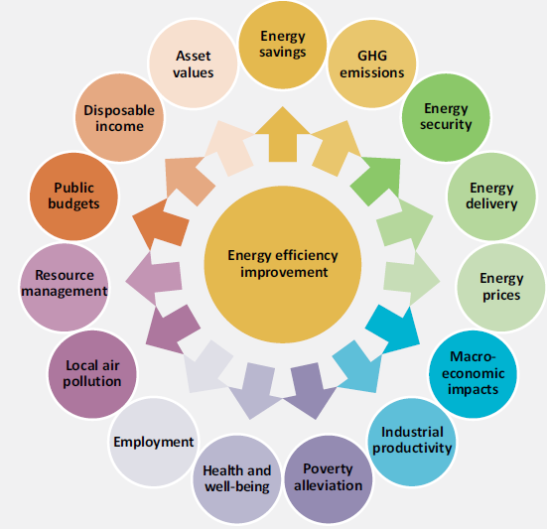
Energy efficiency – for many good reasons, including half of GHG reduction potential to 2030
Source: IEA WEO Special Report 2015
Source: IEA Capturing the Multiple Benefits of Energy Efficiency, 2014

Slide 34

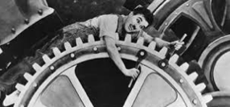

Exchange equipment, save energy cost, and pay back investment
Scenario with existing equipment
Scenario with EE equipment
Savings
Maintenance cost
Investment
Maintenance cost
Energy cost
Energy cost
period of 5 years
period of 5 years

Slide 35
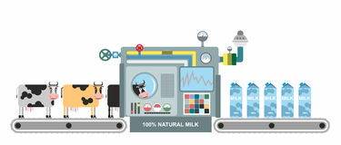


  ESI Initial Sectors
Mexico : agro-industry
≈ 4,900 enterprises
Target ⇨ 190 projects
Investment ⇨ USD 25 million
Colombia: Hospitals/Hotels
≈ 1,100 private Hospitals
≈ 6,800 Hotels
Target ⇨ 125 projects
Investment ⇨ USD 25 million

Slide 36
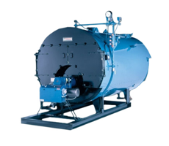

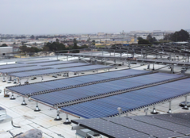

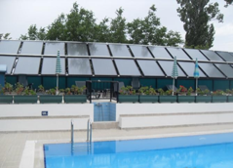
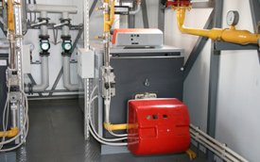
  ESI Focus: Standardized technologies
Investments from USD 50K to 1 million; payback from 2 till 5 years
Air conditioning system
Solar water heating systems
Industrial boilers
Automation System
Solar pool heating systems
Cogeneration

Slide 37

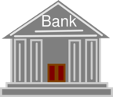

  Why does it not work so easily? Barriers and risks
Enterprises
Financial Institutions
Solution Providers
Notes:
Enterprises
Not a priority (compete with other investments)
Lack of understanding
Lack of trust
Solution Providers
Not used to sell/guarantee “Energy savings”
Do not have financing capacity
Financial Institutions
Lend to companies NOT projects
Lack of understanding on EE

Slide 38
  The ESI toolkit: A package of measures to address barriers and mobilise private investments
Market assessment
Capacity building
Financing structure
Energy Savings Insurance
Marketing and communi-cations plan
Standardized performance contract
Validation and verification

Slide 39

  Developing EE markets:
  Addressing risks; mobilizing demand and supply; providing finance.
1 Performance contract
SME
4 Credit line
Insurance
LFI
Provider
Re-insurance
NDB
Validator
3 Risk coverage
MDB
Validation
Donor

Slide 40
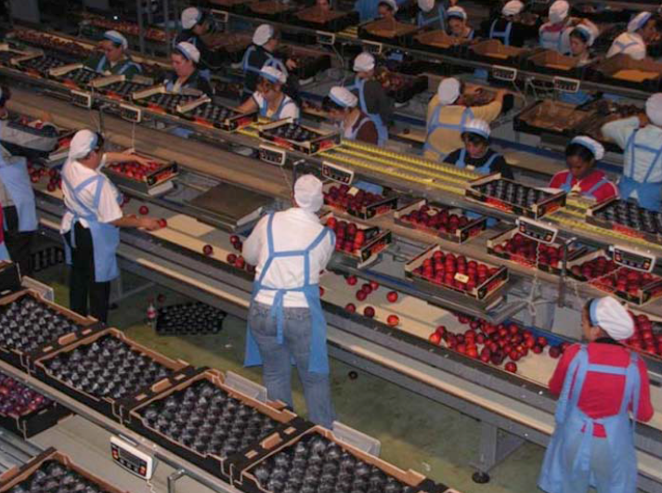
  The foundation: Understanding the market and its potential
In-depth analysis :
Priority sector(s) with EE potential
Key actors: businesses, technology providers, financial institutions
Existing initiatives
Financing options
Outcome:
A report on the state of the market, with recommendations on adapted ESI mechanisms.

Slide 41
  The standardized performance contract:
  Incentives and certainty

Slide 42
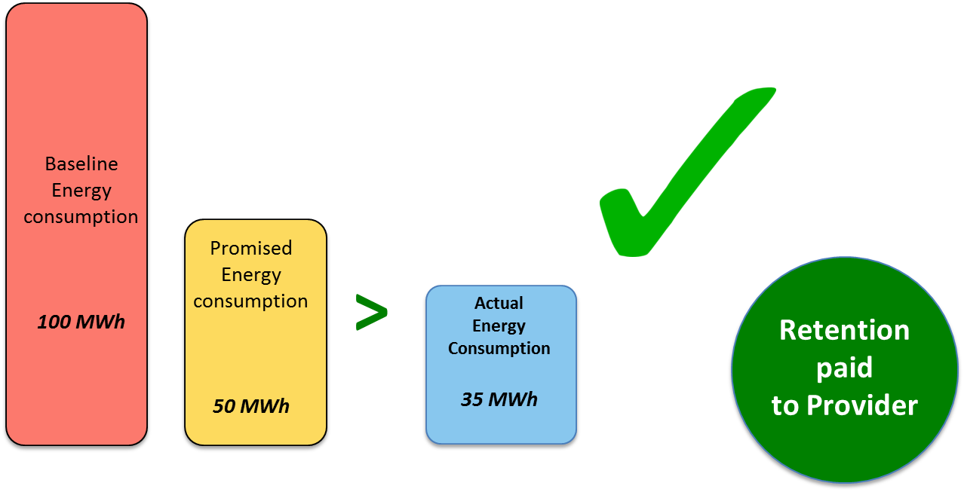
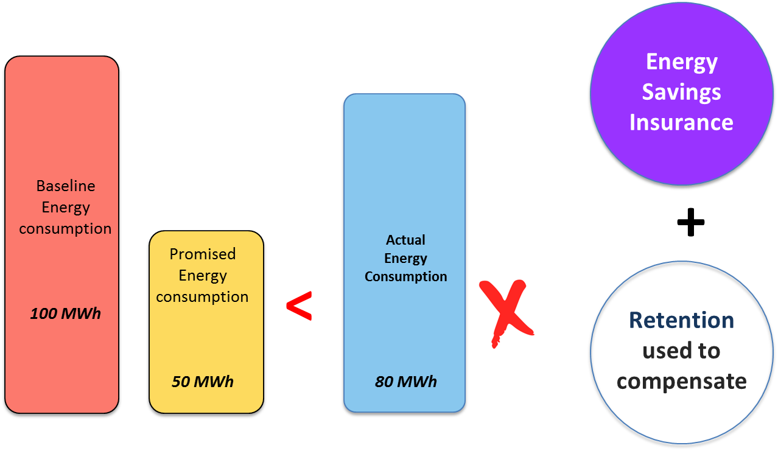
  “Performing” and non-performing scenarios

Slide 43
  Independent Validation Mechanisms:
  Gives trust in the project and the technology provider
Validation of project and provider
Verification of project installation
Validation of project report
Evaluation
Evaluation
Evaluation
Evaluation
Installation
Operational

Slide 44

ESI – state of play
Next steps
Replicate and scale up ESI in Latin America and Caribbean.
Govt. of Denmark has pledged support, others may join.
Interest in other regions – Asia, Africa.
IDB establishing knowledge sharing platform.
Recognition and support for ESI from “Innovation Lab”
Aims to drive billions of dollars of private investment into climate change in developing countries.
Has now launched a second cycle and an international call for ideas.

Slide 45
  Introducing the ESI package in a country and sector
1
3
  EE market
  Champion
Ministries & Initiatives
Actors
2
4
5
7
Standard contract and Validation Procedures
Management information system
  Marketing strategy
Training
6
8

Slide 46
  Breakout -questions
  Implementing the ESI program in your country
Do the proposed ESI measures address the main EE challenges to EE market development in your country? Which ESI measures are most important to include in your country?
1
Which public and private entities would have to be involved in your country (e.g. specific ministries, business associations, etc.) ?
Which complementary policy and regulatory measures would help ESI?
2
In the pilot countries in Latin America, National Development Banks have been “champions” in introducing ESI. Which organization(s) could manage an ESI program in your country?
3

Slide 47

Energy Savings Insurance
THANK YOU!
For more information please contact
Maria Netto - mnetto@iadb.org
José Juan Gomes - joseg@iadb.org
Asger Garnak - asgerg@iadb.org
Daniel Magallon - Daniel.magallon@energy-base.org

Slide 48

Mobilizing private finance in your country
In groups of 5-8 with both country and technical representation
Identify a time-keeper, a rapporteur/note-taker and a presenter who will report out
Review the discussions questions
Agree on 2-4 questions to be the focus of group discussion
Share your experiences, successes, and challenges.
Discuss lessons learned and shared challenges that remain
Identify key areas for LEDS GP support that could effect transformative change
Capture ideas on the output template sheets
In considering financial instruments and innovative risk mitigation instruments:
1) Do the proposed ESI measures address the main EE challenges to EE market development in your country? Which ESI measures are most important to include in your country? Which public and private entities would have to be involved in your country? Which complementary policy and regulatory measures would help ESI? Which organization(s) could manage an ESI program in your country?
2)Beyond the specific example of the ESI, what recent opportunities have there been to apply other instruments/approaches from the LEDS toolkit (or other sources) that provide insight into barriers and opportunities for attracting greater private investment in climate change mitigation and adaptation projects? Have you been able to identify and track climate change related investments made with private finance?
3) What next steps are you planning to address any perceived barriers and promote greater private investment in climate change projects?
4) How can the LEDS GP support your forthcoming efforts in your country, or across countries (global or regional)?

Slide 49
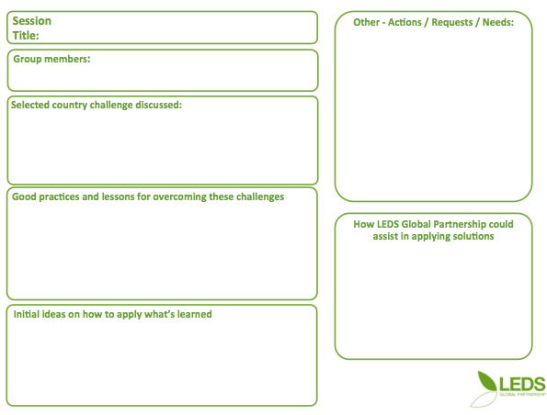
Capturing discussion points and outputs
In your learning group:
before you finish your session please be sure to complete your output sheet!

Slide 50

Hearing back from you
Main insights
Lessons learned and new ideas
How can LEDS GP support efforts?
Please hand your output sheet to
the moderator
Please join the LEDS GP and encourage others to join.
www.ledsgp.org

Slide 51

Last thoughts….

Slide 52
Questions to inform leveraging of private finance
Policymakers and climate negotiators should be structuring the discussions on private climate finance in line with the following sequence of questions:
What is the typical funding profile for each of these project categories? Who are the main financial actors? What kind of private finance is required for successful implementation?
What are the main barriers currently keeping private capital from these project categories, noting that barriers are often specific to the kinds of finance required?
What kinds of existing public intervention have successfully overcome these barriers? Can they be strengthened, expanded or copied with the support of the global climate regime?

Slide 53
USAID CEADIR Climate Finance E-Tool
USAID CEADIR plans an e-tool focused on financing climate change initiatives at the national and subnational (not project) level
Will be dynamic, reflecting differences in national needs, financial resources, and policy environment
Envisions input from public and private communities, with public finance being used to leverage greater private investment
Will be modular to allow countries to focus on topics most relevant to their needs
Will draw on country experiences.
A software product (potentially mobile application) to allow for revision and updates

Slide 54

Thank you!!!

Slide 55
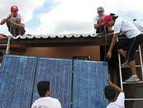
About CEADIR
CEADIR supports countries to assess and scale up low-carbon, climate resilient development.
For more information about CEADIR’s work in financing climate change activities?
  Michele Laird, CEADIR project, michele_laird@abtassoc.com
  Alan Miller, CEADIR project, astanley92@gmail.com
CEADIR Series
Expert dialogues
Critical issues
Economic analysis
Financing climate change
Additional questions about CEADIR?
  Dr. Marcia Trump, Chief of Party, CEADIR project, marcia_trump@abtassoc.com
  Robert Voetsch, Project Manager, CEADIR project, rvoetsch@crownagents.com

