Slide 1
Investment Planning and Implementation for Low Emissions Development
LEDS Global Partnership Annual Workshop
Punta Cana, Dominican Republic
October 14-16, 2015

Slide 2
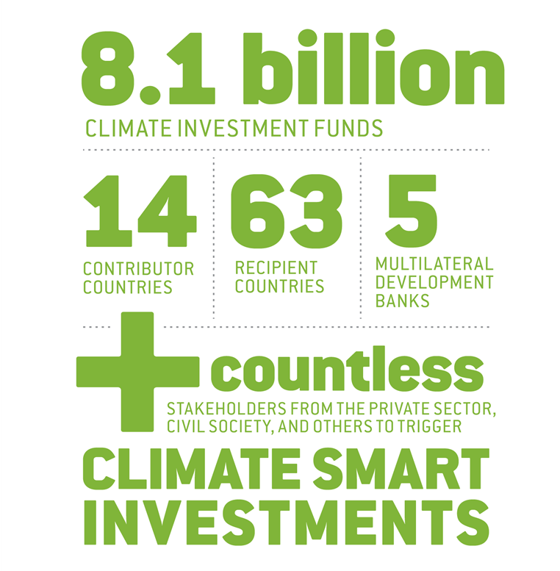
CIF as a Partnership

Slide 3
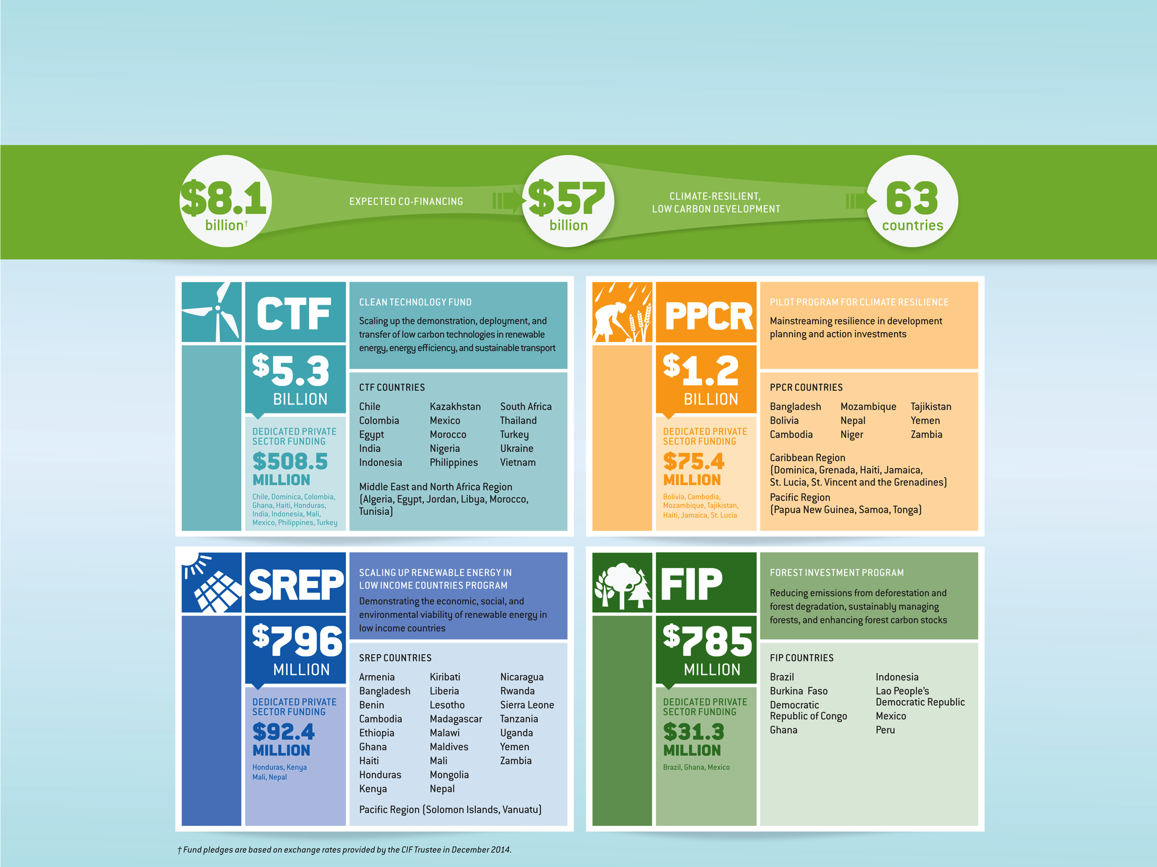
Programs of the CIF

Slide 4
CTF Overview

Slide 5
Expression of Interest
Selection of Countries
Based on recommendations of Independent experts, the governing body approves selection of countries.
Scoping/Joint Missions
Development of Investment Plan
Endorsement of Investment Plan
Governments continue to develop and finalize investment plans in consultation with stakeholders.
The governing body endorses the investment plan, which allows countries to move forward with developing projects identified in the plan.
Development of Projects/Programs
Approval of CIF Funding
Countries and MDBs develop projects to be submitted for funding approval by the governing body.
Prior to MDB board approval, the country and MDB submit the project to the governing body for approval of CIF funding.
Project/Program Implementation
Monitoring and Evaluation
Once approved by the MDB board, the project enters the implementation stage.
Projects are monitored and evaluated following MDB procedures; results are reported and lessons learned shared.
Governments invite the MDBs to scoping/joint missions to develop investment plans.
Expressions of interest from eligible countries are invited.
Phase 1: Pre-investment
CIF Programming Process
Phase 2: Implementation

Slide 6
The CIF Approach
Country ownership
Inclusive governance
Partnership
Stakeholder engagement
Programmatic approach
Attracting private investment
Strong financial leverage
Targeted knowledge sharing
Achieving results
Transparency and Accountability

Slide 7
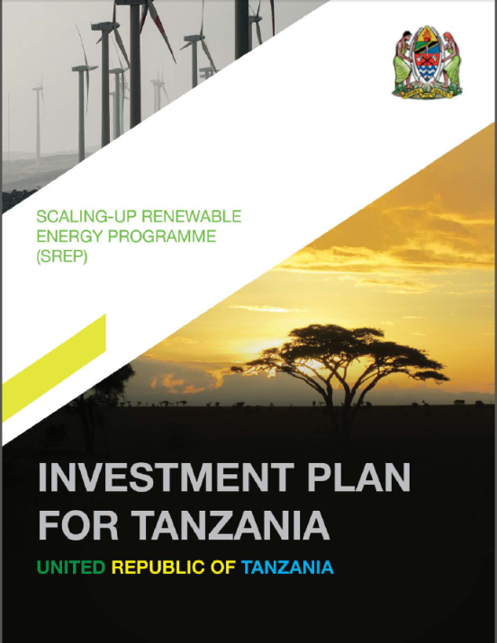
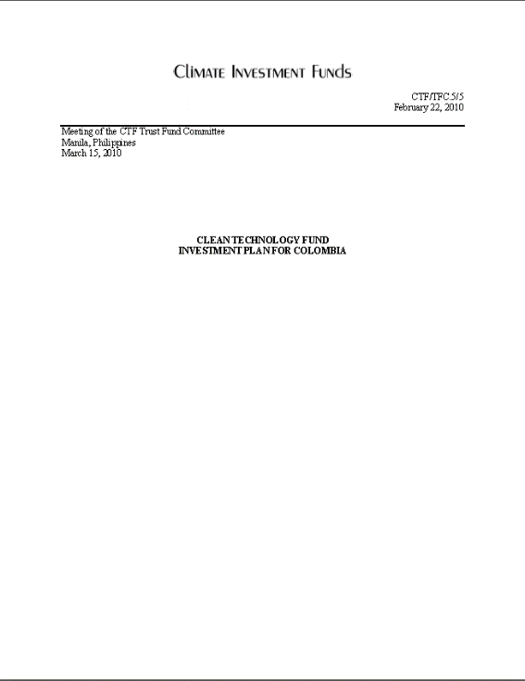
Low Emissions Investment Plans
A proposal for the programmatic use of climate finance…
CTF Investment Plan | SREP Investment Plan
Country and Sector Context Enabling Policy and Regulatory Environment Priority Sectors and Rational Project Concepts and Rationale Financing Plan and Instruments Monitoring and Reporting Knowledge and Learning | Country and Sector Context Institutional Framework and Risks Technical Assistance and Capacity Building Priority Sectors and Rational Project Concepts and Rationale Financing Plan and Instruments Monitoring and Reporting Knowledge and Learning
Note: The investment plan may also include an annex that has one or more of these sections included, as well as additional relevant details that would help inform the governing bodies.
Notes:
A country’s low emissions investment plan is a clearly articulated proposal for the programmatic use of climate finance. In the CIF, the programmatic use of climate finance refers to an approach to planning that aims to transform a whole sector or economy, rather than develop individual projects. The goal of this approach is to build capacity and create lasting institutional infrastructure in the country. The portfolio of measures chosen by each country for their investment plan will be specific to its national context, but in general, these measures will include public and/or private investments leading to the deployment of different low emission technologies and their operational management, as well as the associated capacity building and advisory services to support the removal of deployment barriers.
As you can see here, a typical CTF investment plan for a middle-income country includes the country and sector context, information on the enabling policy and regulatory environment, priority sectors and the rationale for prioritizing them out of available options, a financing plan including an outline of financial instruments and sources, a framework for monitoring and reporting, and the incorporation of knowledge and learning to facilitate improvements, scale-ups and/or replication. A typical SREP investment plan for a low income country is quite similar to a CTF investment plan; however, there are a few key differences related to the country’s low income status. In an SREP investment plan, special attention must be given to the country’s existing institutional framework, as well as an explanation of the known or projected risks, how those risks might be overcome, and the technical assistance and capacity building needed for success. This could include policy and regulatory guidance and support, institutional strengthening, and human and financial capital resource support. Both CTF and SREP investment plans also include a list of high level project concepts. In some cases, one or more of the sections outlined in the table above could be included in the investment plan as an annex, depending on the country’s specific circumstances, needs, and the level of detail required to describe them.

Slide 8
LEIP Development Process
Initiating Stakeholder Engagement
Form a planning committee
Scoping Country Context
Prioritizing Sector Options
Conduct policy review
Identify key stakeholders
Revisions
Periodic review
Conduct sector analyses
Development of project concepts
Implementation
Assess implementation potential and risk
Assess existing project pipeline
Select financing strategy
Design M&R strategy
Notes:
In the CIF experience, the timeframe for developing a low emissions investment plan can last anywhere from 2 months to 24 months, depending on country capacity, level of preparation, and various other factors, such as stakeholder engagement and political processes. For the purposes of this eCourse, the process has been broken down into 4 major phases.
The first phase in developing a low emissions investment plan is scoping, which entails formulating a planning group or committee and identifying key stakeholders to engage during the process and scoping and defining the country context, which includes economic conditions, energy resources, policy environment, and institutional capacity. In this diagram and throughout the course, we’ve separated Scoping into two major components, as the process of initiating stakeholder engagement begins in scoping, but continues on throughout the remainder of the investment planning process and is important to emphasize. As you’ll see later, we’ll return stakeholder engagement during each phase of the investment planning process. The second phase in developing a low emissions investment plan is the prioritization of low emissions sectors, which includes assessing implementation potential and risks. The third phase in developing a low emissions investment plan is the development of project concepts, defining a monitoring and reporting strategy and a strategy for mobilizing financing. Finally, the fourth phase in developing a low emissions investment plan is implementation, which includes conducting periodic reviews and making any revisions to the plan, as necessary. After learning about these phases, you will have an understanding of the major components of completing a low emissions investment plan, as well as when to engage with stakeholders throughout the process.

Slide 9
Zhihong Zhang, Ph.D. Senior Program Coordinator (CTF and SREP) zzhang2@worldbank.org +1 202 473 9852
www.climateinvestmentfunds.org @CIF_Action https://www.youtube.com/user/CIFaction https://www.flickr.com/photos/cifaction/sets

