Slide 1

The Green Climate Fund
Carmen Arguello
LEDS-GP
Punta Cana, DR
14-16 October 2015
Notes:
Opportunity for countries to accelerate access
Strengthening knowledge & understanding
Collaborating with peers & partners
Making concrete progress
Overview of the Fund
Fifty thousand foot view
Introduce core pillars
Whet your appetite – stimulate questions that we will answer during the course of the day

Slide 2
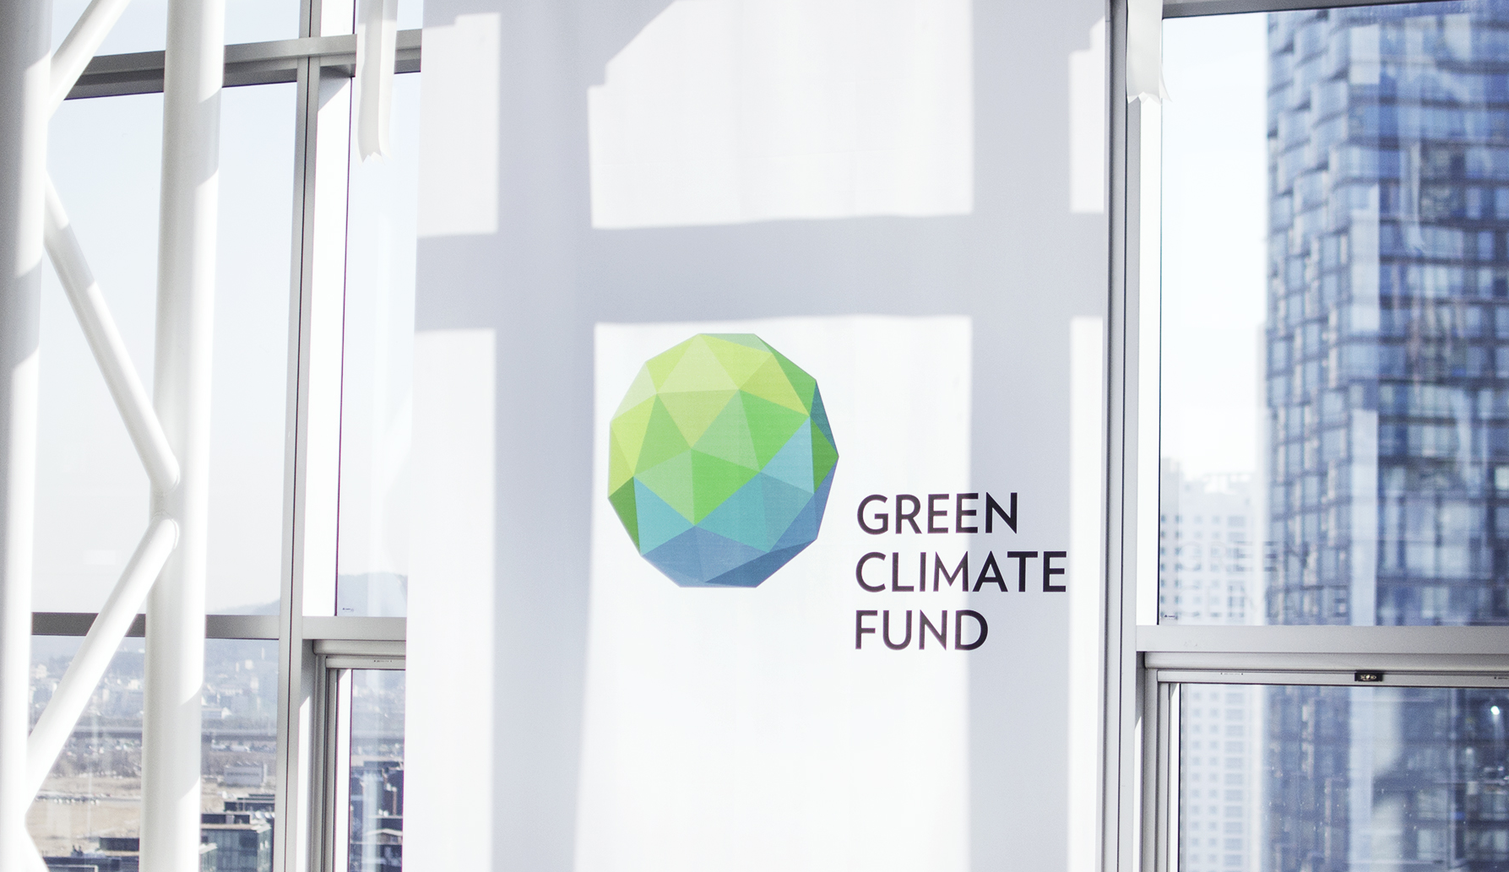
About the Fund
NAME | GREEN CLIMATE FUND
TYPE | Financial Mechanism of the Convention - UNFCCC
ESTABLISHED | 11 December 2010 in Cancun, Mexico
STAKEHOLDERS | 194 Countries Signatories to the UNFCCC
GOVERNANCE | Board + Secretariat + Independent Accountability Units Equal Board members from developing and developed countries
MANDATE | To promote low-emission and climate-resilient development in developing countries
HEADQUARTERS | Songdo, Republic of Korea
Notes:
Start with some basic facts
Who we are?
Multilateral fund
Financial mechanism of the convention
Governed by 24 Board members & headquartered in Songdo, Korea
Why we’re here?
Small island developing states and other developing countries wanted such a fund
To promote climate-resilient, low-emission development in developing countries

Slide 3
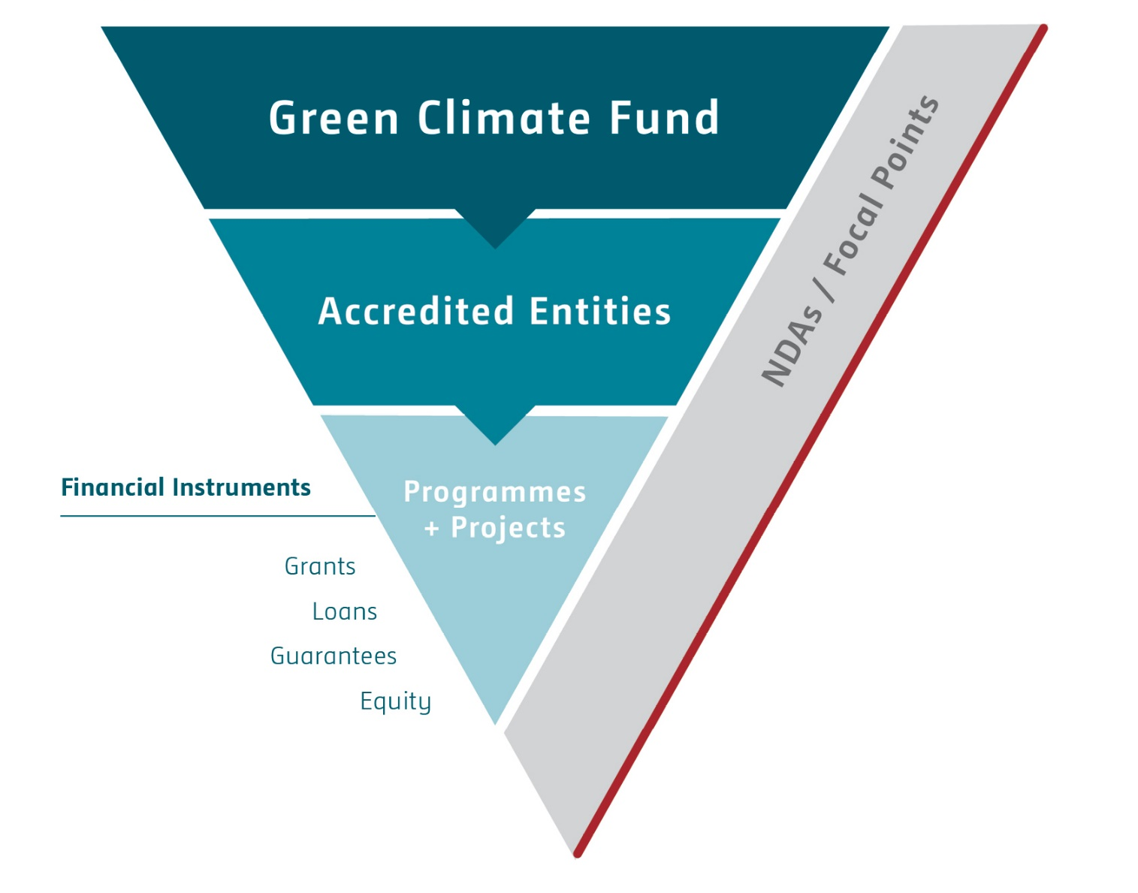
Fund architecture
Notes:
Simple picture of the architecture
Fund with resources flowing through accredited entities
To climate change projects/programmes in countries
Using one of four financial instruments or a combination
With NDAs/focal points playing a key role all through

Slide 4
How to engage with the Fund?
Project/Programme Proposals
Accreditation
Readiness

Slide 5
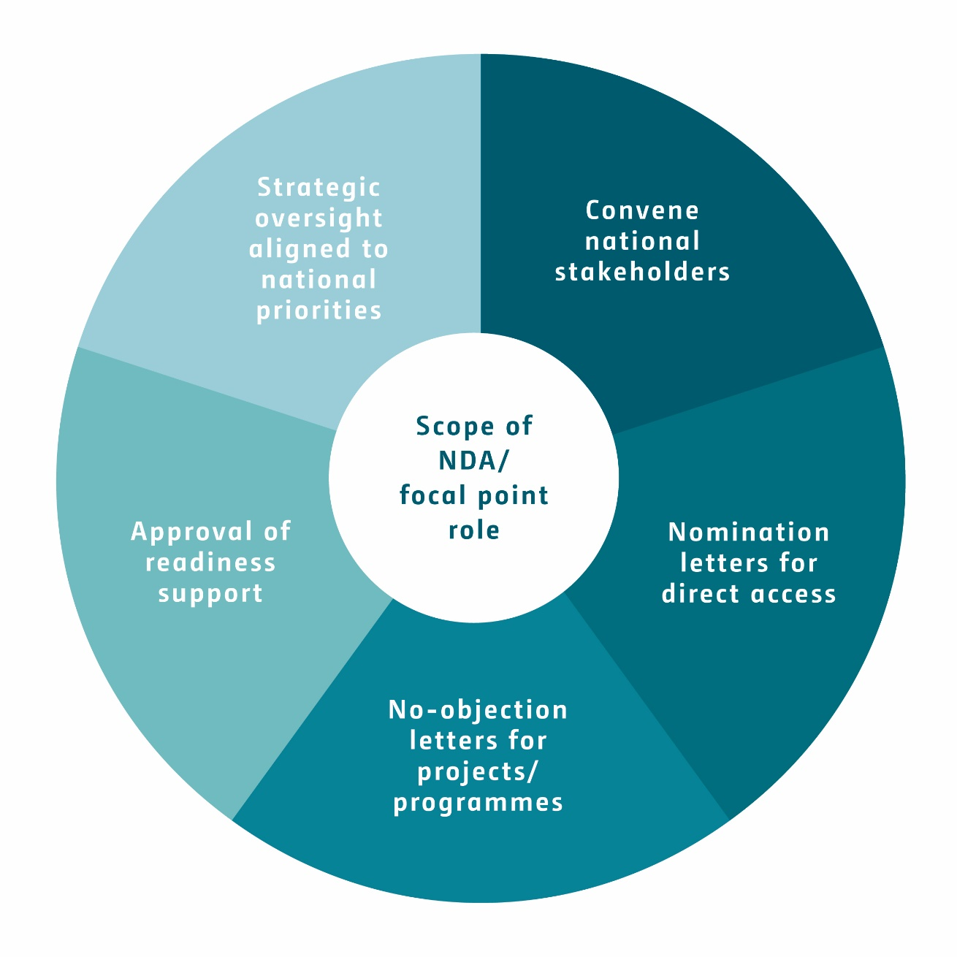
Roles of NDAs and focal points
Notes:
Play some very important roles in the Fund’s operations
Strategic alignment with country priorities
Identify entities to work with, and even nominate direct access entities
Approve projects before the Fund considers it through no-objection procedure
Also approve deployment of readiness support available

Slide 6
NDAs, focal points and
readiness overview
Readiness status (as of 1 Oct)
135 NDAs or focal points
87 readiness requests
$4.6 million committed
17 NDAs/focal points
Notes:
Just on readiness, it’s really starting to take off in the last couple of months
- Until May, we had only committed readiness support to 1 country
- Now, we’re at 17 and likely to be around 30 by the end of the year
We have committed resources to two countries in the Caribbean – Antigua & Barbuda, and Dominican Republic
Hope to have several others after this workshop
Cover more on the role of the NDAs and focal points, and readiness tomorrow

Slide 7
Access to Green Climate Fund resources
Through a country-driven approach, the National Designated Authority (NDA) of a country can identify the strategy by which it will address climate change, and provide broad strategic oversight of the Fund’s activities in the country.
Access to Fund resources to undertake climate change projects/programmes will be through accredited national, regional and international implementing entities and intermediaries.
Entities seeking accreditation to the Fund in order to access its resources will be assessed against the Fund’s fiduciary principles and standards, environmental and social safeguards (ESS) and gender policy.
8
Notes:
Through the 3-stage accreditation process and the fit-for-purpose approach, entities will be accredited for certain fiduciary functions, size of project/activity within a programme, and environmental and social risk category.
Entities can apply on a rolling basis and applications are reviewed on a rolling basis. Decisions on accreditation will be made by the Board at its meetings.

Slide 8




















Accredited entities
Regional
National
Ministry of Natural Resources of Rwanda
International
Notes:
If NDAs and focal points are at the heart of the Fund, the accredited entities are the arteries
They carry the much needed resources (the blood) to the different parts of the economy and society
To help make people, infrastructure, and ecosystems more resilient to the impacts of climate change, and reduce GHG emissions from human activities
They may be of different kinds – big, small, regional, national or international – with different capacities and reach
The objective is that they deliver resources where its most needed

Slide 9
Fit-for-purpose approach to accreditation
Entities will be accredited with certain fiduciary functions, size of project/activity within a programme, and environmental risk category.
Fiduciary functions
Size of project/activity within a programme
Environmental and social risk category
Shapes how the entity will operate using the Fund’s resources (e.g., grants, concessional loans, equity, guarantees)
Micro
Small
Medium
Large
High risk Category A/ Intermediation I (I-1)
Medium Category B/I-2
Low/no Category C/I-3
14

Slide 10
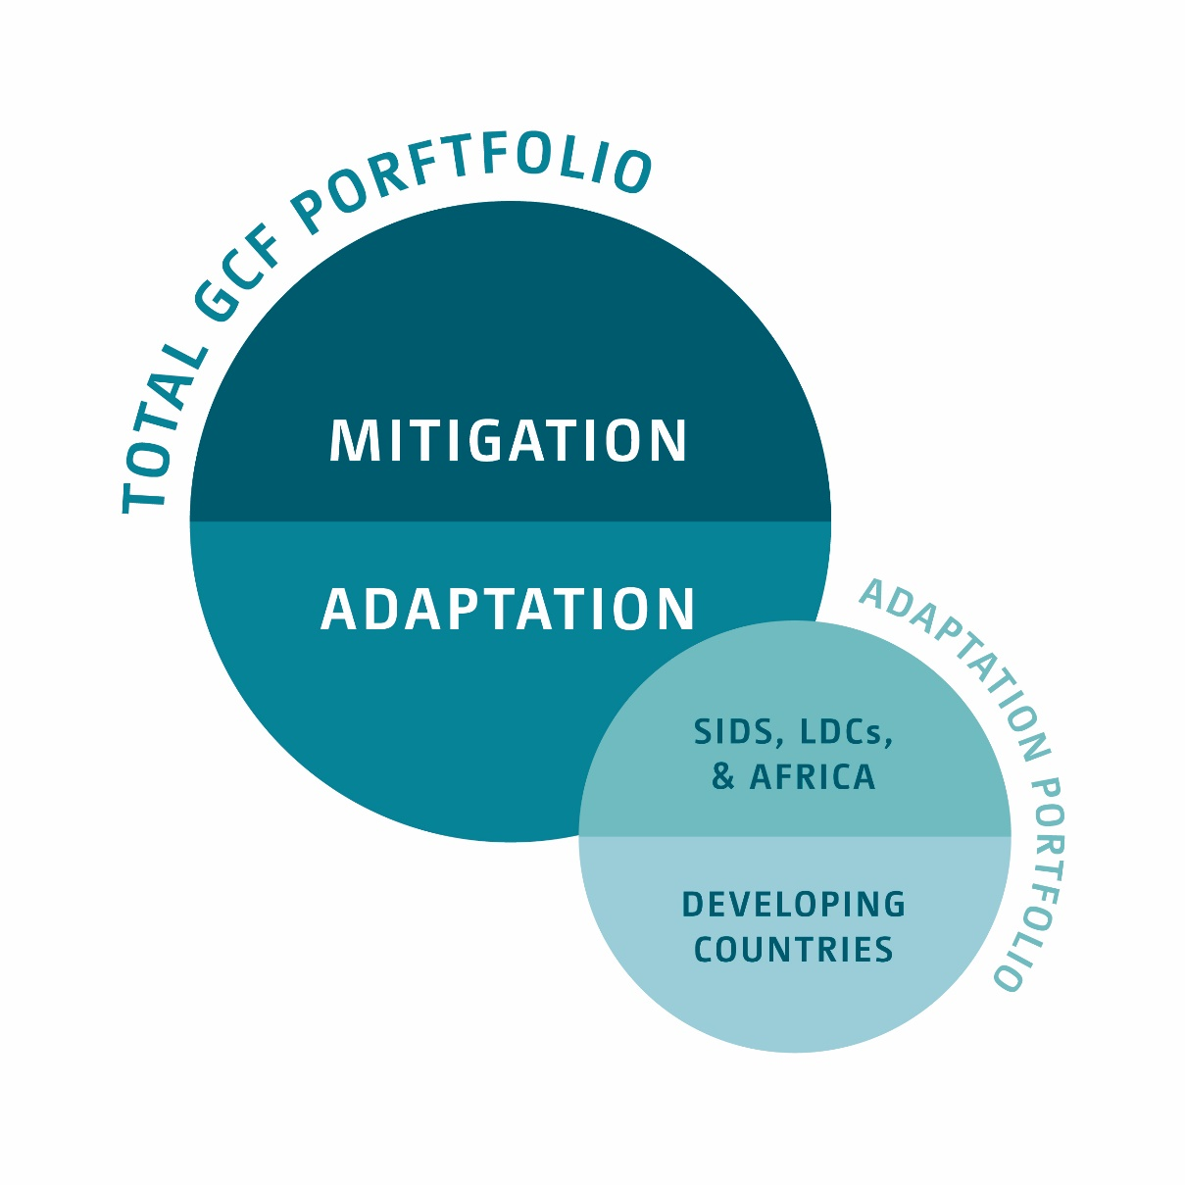
Resources & allocation
$10.2 billion in pledges
$5.8 billion in signed contributions (1 Oct)
37 governments, 8 developing countries
Geographical balance
Sufficient resources for readiness
Significant allocation to private sector
Notes:
Resources we have and how we’re expected to balance the overall portfolio over time
Here’s what we have:
10.2 billion in pledges
5.8 converted into signed contributions that we can commit
Comes from 37 countries, 8 developing
Here’s how we need to allocate:
50% each to adaptation & mitigation (overall, not by country, and measured in grant-equivalent terms)
50% of adaptation has to go to SIDS, LDCs & African states
Ensure geographical balance but no country allocations
Significant allocation to the private sector
Sufficient resources for readiness (have $16million released, of which $4.6 million committed to 17 countries)
Resources and allocation targets

Slide 11
Financial Instruments
Terms determined on a case-by-case basis
2
1
Equity
Grants
3
4
Guarantees
Concessional loans
Notes:
Fund has the ability to deploy 4 types of financial instruments – grants, equity, guarantees and loans
Grants with/without repayment contingency
Loans with high concessionality – 40 years maturity, 10 years grace, 0% interest
Loans with low concessionality – 20 years maturity, 5 years grace, 0.75% interest
Other non-grant instruments terms determined on a case-by-case basis
On what basis are terms decided?

Slide 12
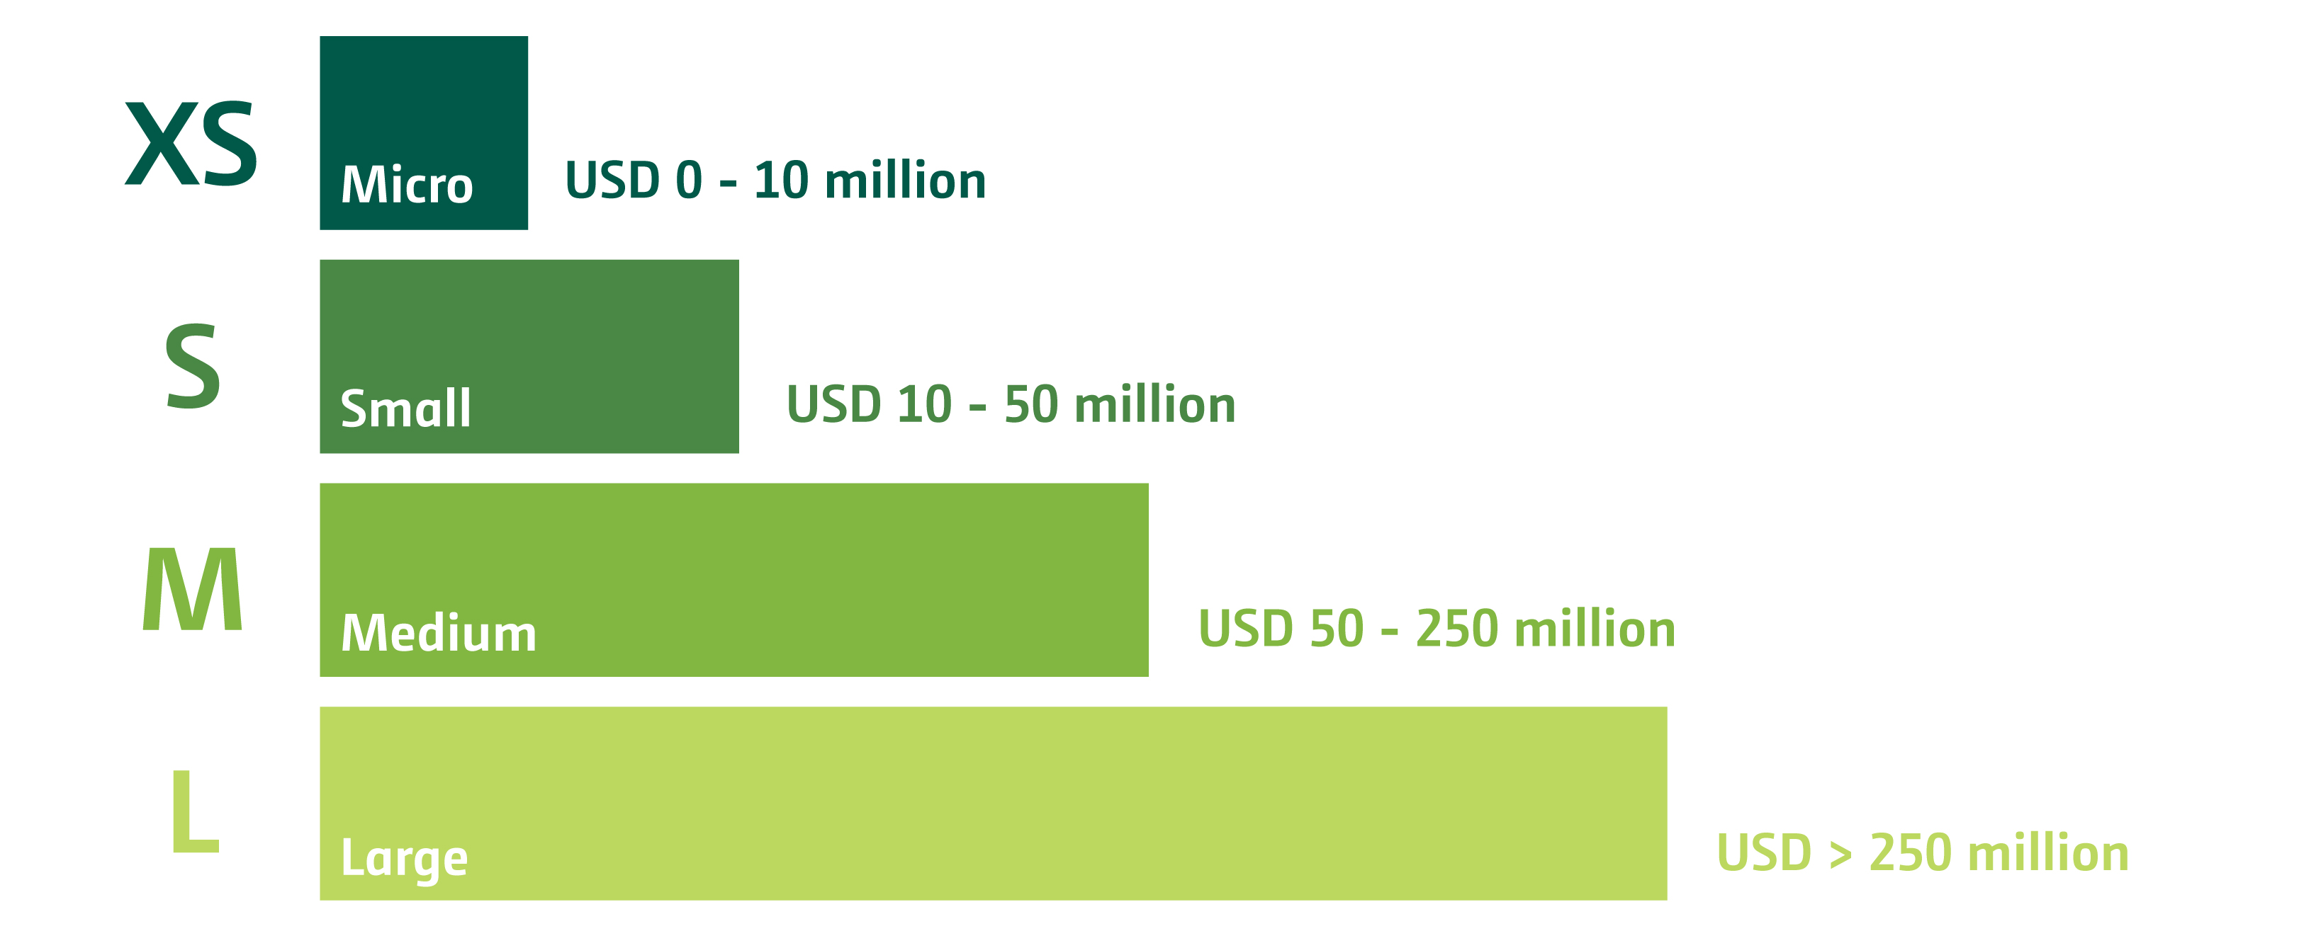
Size of project/activity within a programme
Total Projected Costs*
* At the time of application, irrespective of the portion that is funded by the Fund and,
if applicable, other sources, for an individual project or activity within a programme.
16

Slide 13
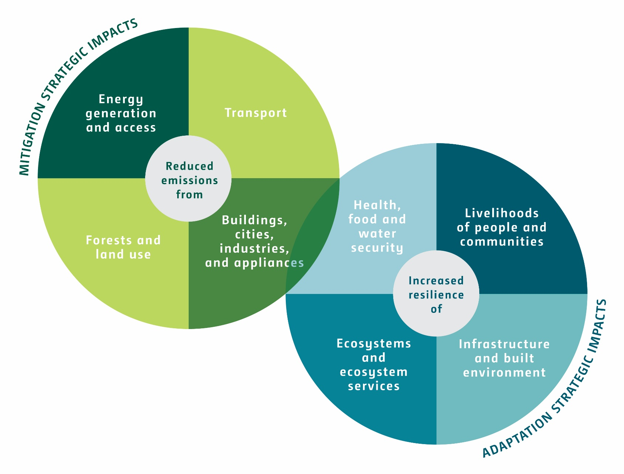
Projects & programmes
With a focus on…
Impacts
Paradigm-shift potential
Crosscutting adaptation-mitigation benefits
Sustainable development co-benefits
Notes:
What areas of mitigation and adaptation will we fund?
Adaptation – Activities that make resilient :
the livelihoods of people and communities
Infrastructure & built environment
Ecosystems & ecosystem services
Health, food & water systems
Mitigation – activities that reduce or avoid emissions:
Energy generation & access
Transport
Appliances, buildings, cities & industries
Forests & land use
For each activity in any of these areas, we will also be looking for impacts, paradigm shift potential, crosscutting benefits & sustainable development co-benefits
Will cover this in more detail in the next presentation

Slide 14
Six Investment Criteria
Impact potential
Paradigm shift potential
Sustainable development potential
Responsive to recipients needs
Promote country ownership
Efficiency & effectiveness
Potential to contribute to achievement of Fund's objectives and result areas
Catalyze impact beyond a one-off investment
Wider economic, environmental, social (gender) co-benefits
Vulnerability and financing needs of beneficiary in targeted group
Country ownership and capacity to implement (policies, climate strategies and institutions)
Economic and, if appropriate, financial soundness, as well as cost-effectiveness and co-financing for mitigation
Notes:
Six high-level investment criteria of the Fund
[READ DEFINITIONS]
These form the high-level filter for assessing funding proposals and are relatively straightforward

Slide 15
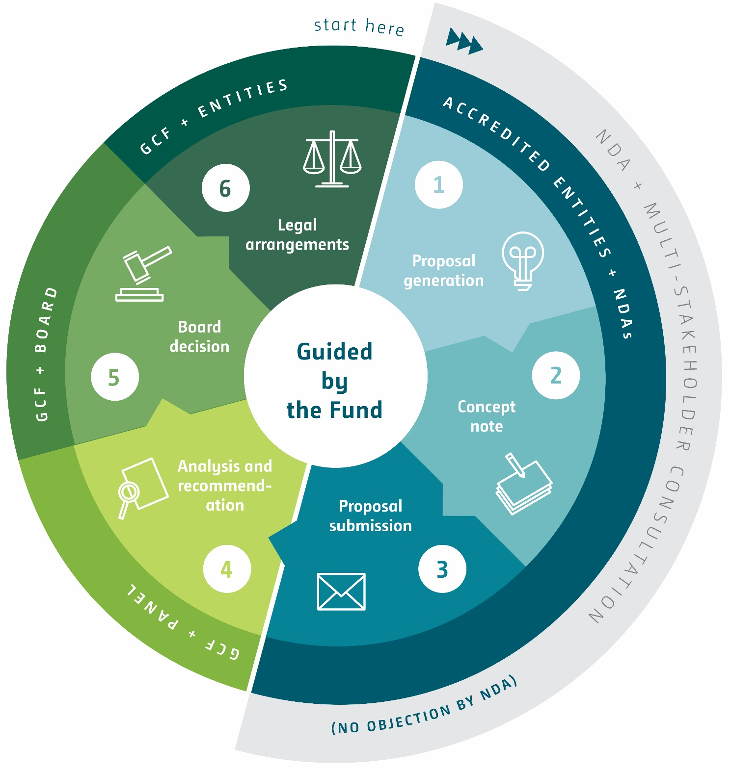
Proposal Approval
Process
Notes:
Lastly, touch on the proposal approval cycle
Generation → Concept Note →Funding Proposal
Iterative process until funding proposal is submitted
Analysis/Recommendatoin → Decision
Decision based on analysis by Secretariat and Technical Advisory Panel
Work under way to simplify the approval process once some experience is gained

Slide 16
Scope of
Readiness Activities
Scope of Readiness Support
Strengthening NDAs/FPs
Developing Strategic Frameworks
Accrediting Entities
Developing Pipelines
Sharing Information & Experiences

Slide 17
Thank you!
Carmen Arguello
Regional Advisor for Latin America
Telephone: +52 1 2221 40 6711
E-mail: carguello@gcfund.org
Website: www.GCFund.org

Slide 18
Notes:
Snapshot view of the Fund
Delve deeper next couple of days

